Slide 1
Postgraduate Festival 2022 Posters Group 2: Mid and later-stage postgraduate researchers
@LJMU_PGRs #PGRFest22

Slide 2
1. Harriet Dunn, EDN

Slide 3
2. Bex Walker, SPS

Slide 4
3. Toni
Blackham,
SPS

Slide 5
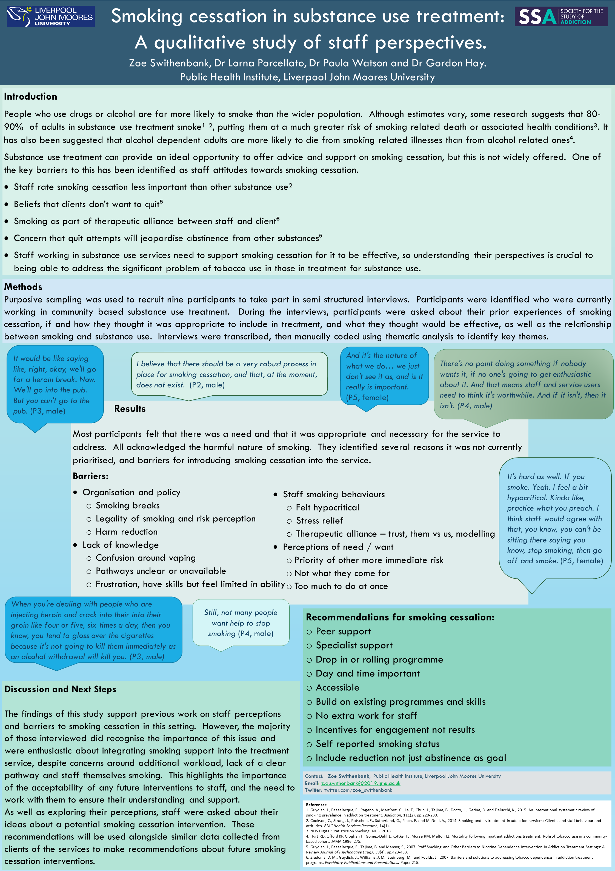
4. Zoe Swithenbank, PHI

Slide 6
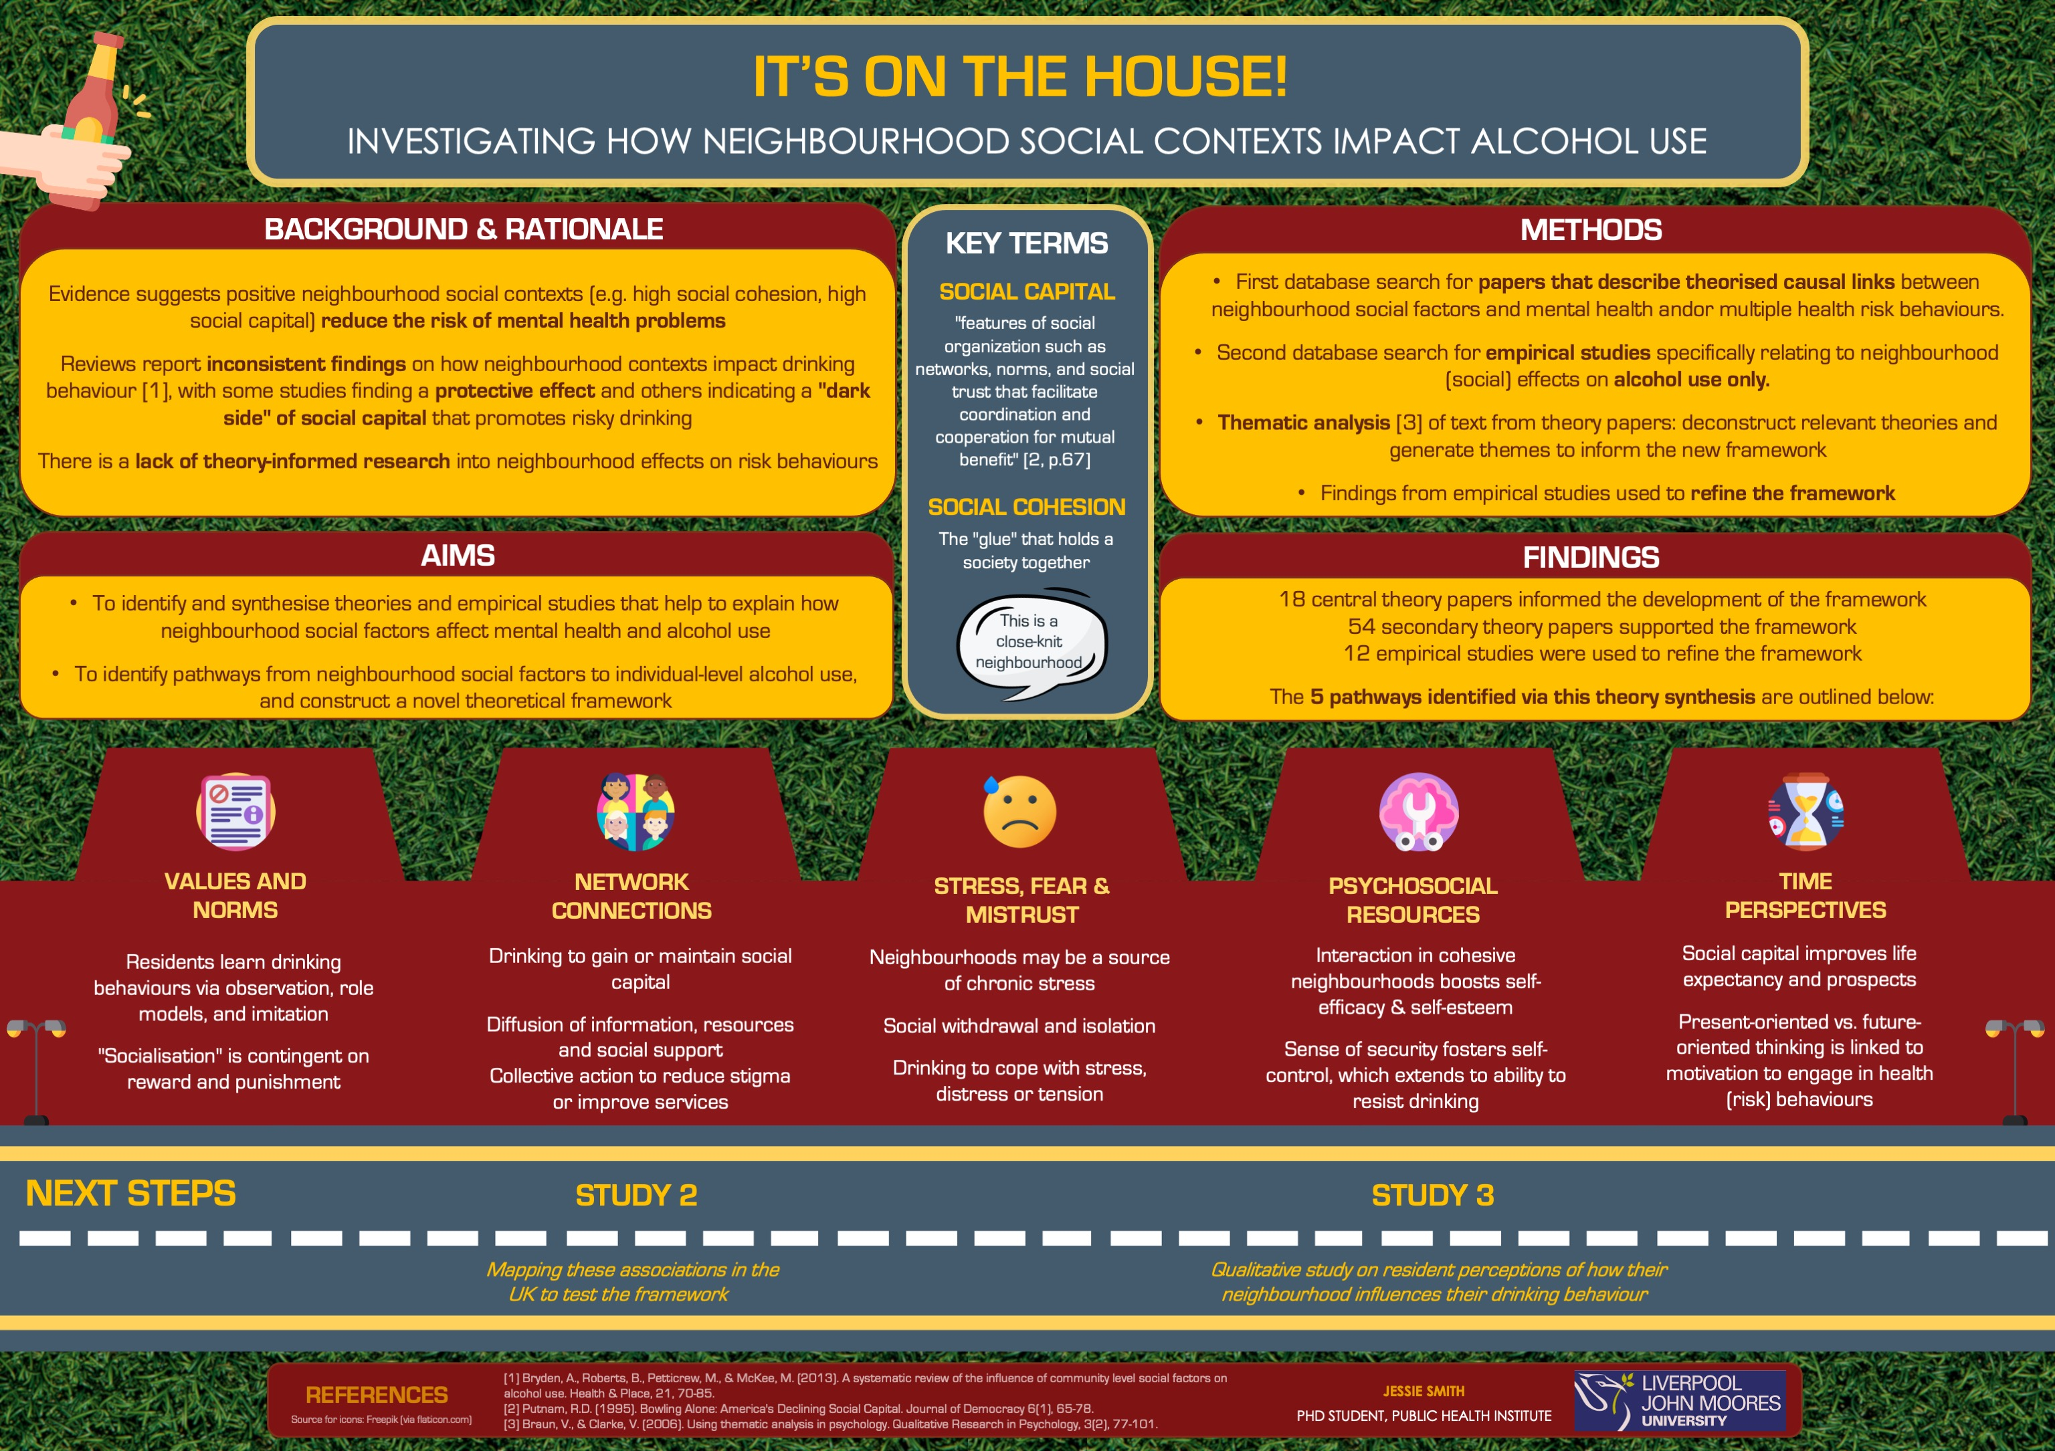
5. Jessie
Smith, PHI

Slide 7
6. Ana Powell, PSY

Slide 8
7. Becky Self, NAH

Slide 9
8. Loredana
Frau, PSY

Slide 10
9. Lauren Coan, CMP

Slide 11
10. Adam Mitchinson, CMP

Slide 12
11. Tianran Ren, ENG

Slide 13
12. Richie Kirwan, BES

Slide 14
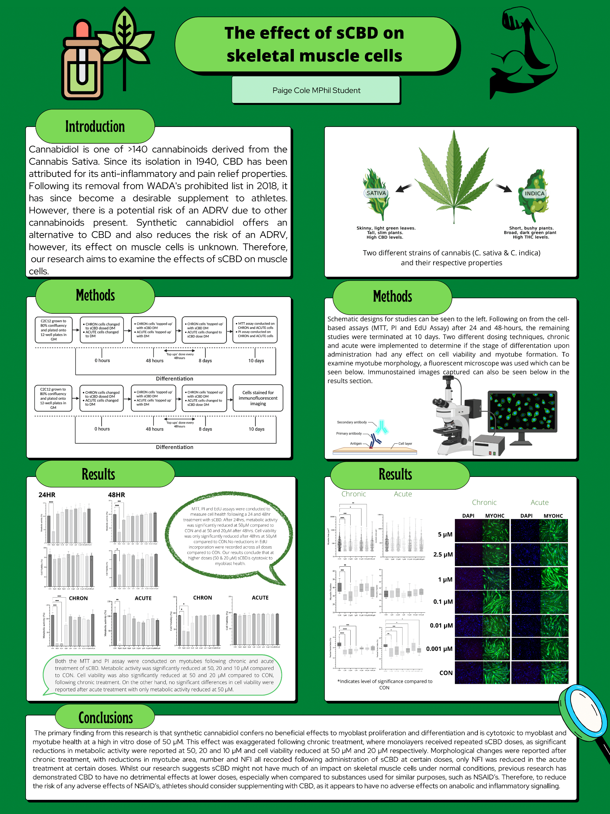
13. Paige Cole, SPS

Slide 15
14. Lucy Dowdall,
BES

Slide 16
15. Stamatia Galata, BES

Slide 17
16. Karyono, CBE

Slide 18
17. Nusrat Jannat, CBE

Slide 19
18. Laura Sheehy, BES

Slide 20
19. Courtney Thompson, PBS

Slide 21
20. Emily Wharton, SPS

Slide 22
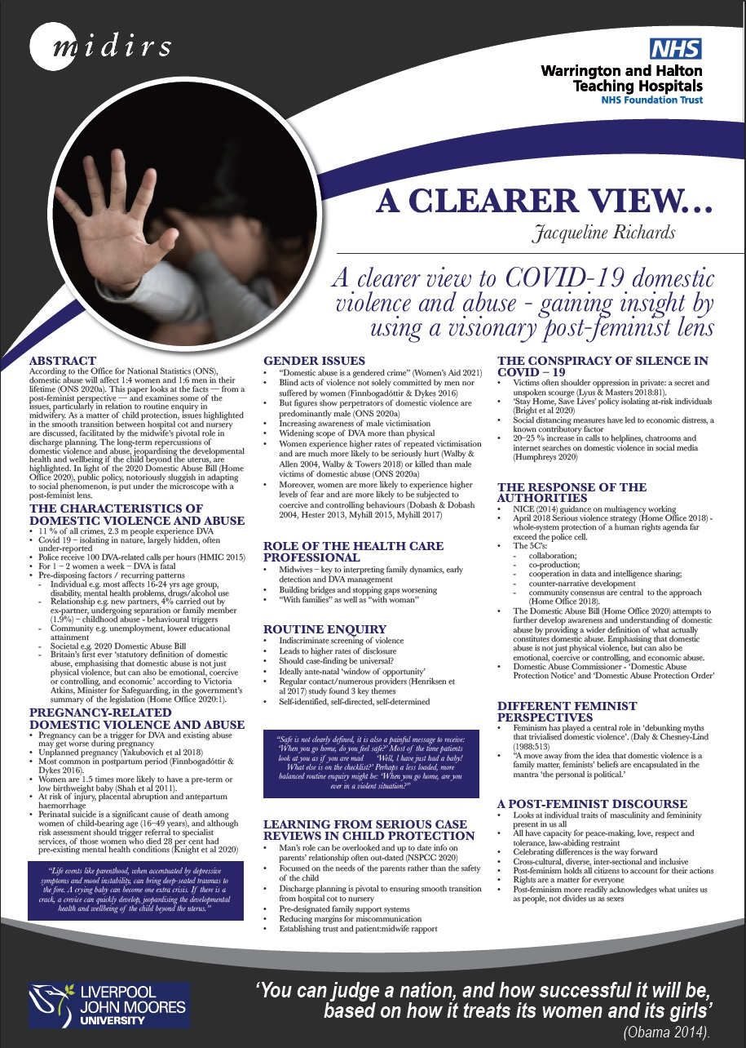
21. Jacqueline Richards, NAH

Slide 23
22. Ryan Clarke, LSS

