Slide 1
Postgraduate Festival 2022 Posters Group 1: Early-stage postgraduate researchers
@LJMU_PGRs #PGRFest22

Slide 2
1. Anita Morris, NAH

Slide 3
2. Bethany Donaghy, PSY

Slide 4
3. Sam Alder,
SPS

Slide 5
4. Oluwaremilekun Adetayo, EDN

Slide 6
6. Zalihe Kamil-Thomas, NAH

Slide 7
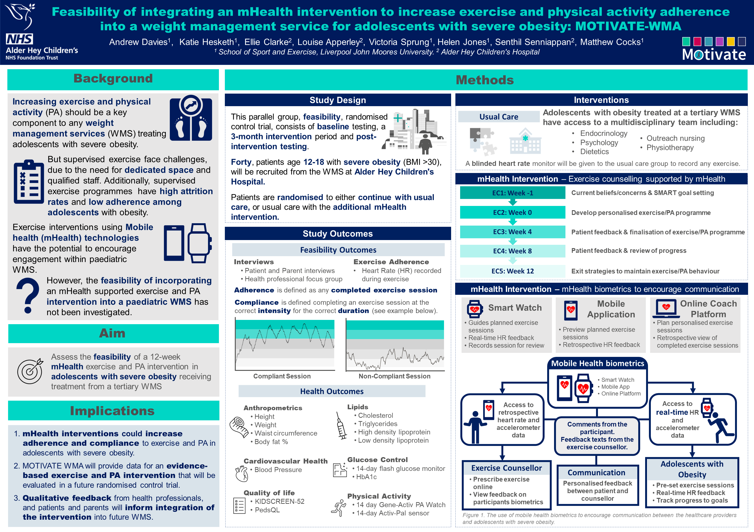
7. Andrew
Davies, SPS

Slide 8
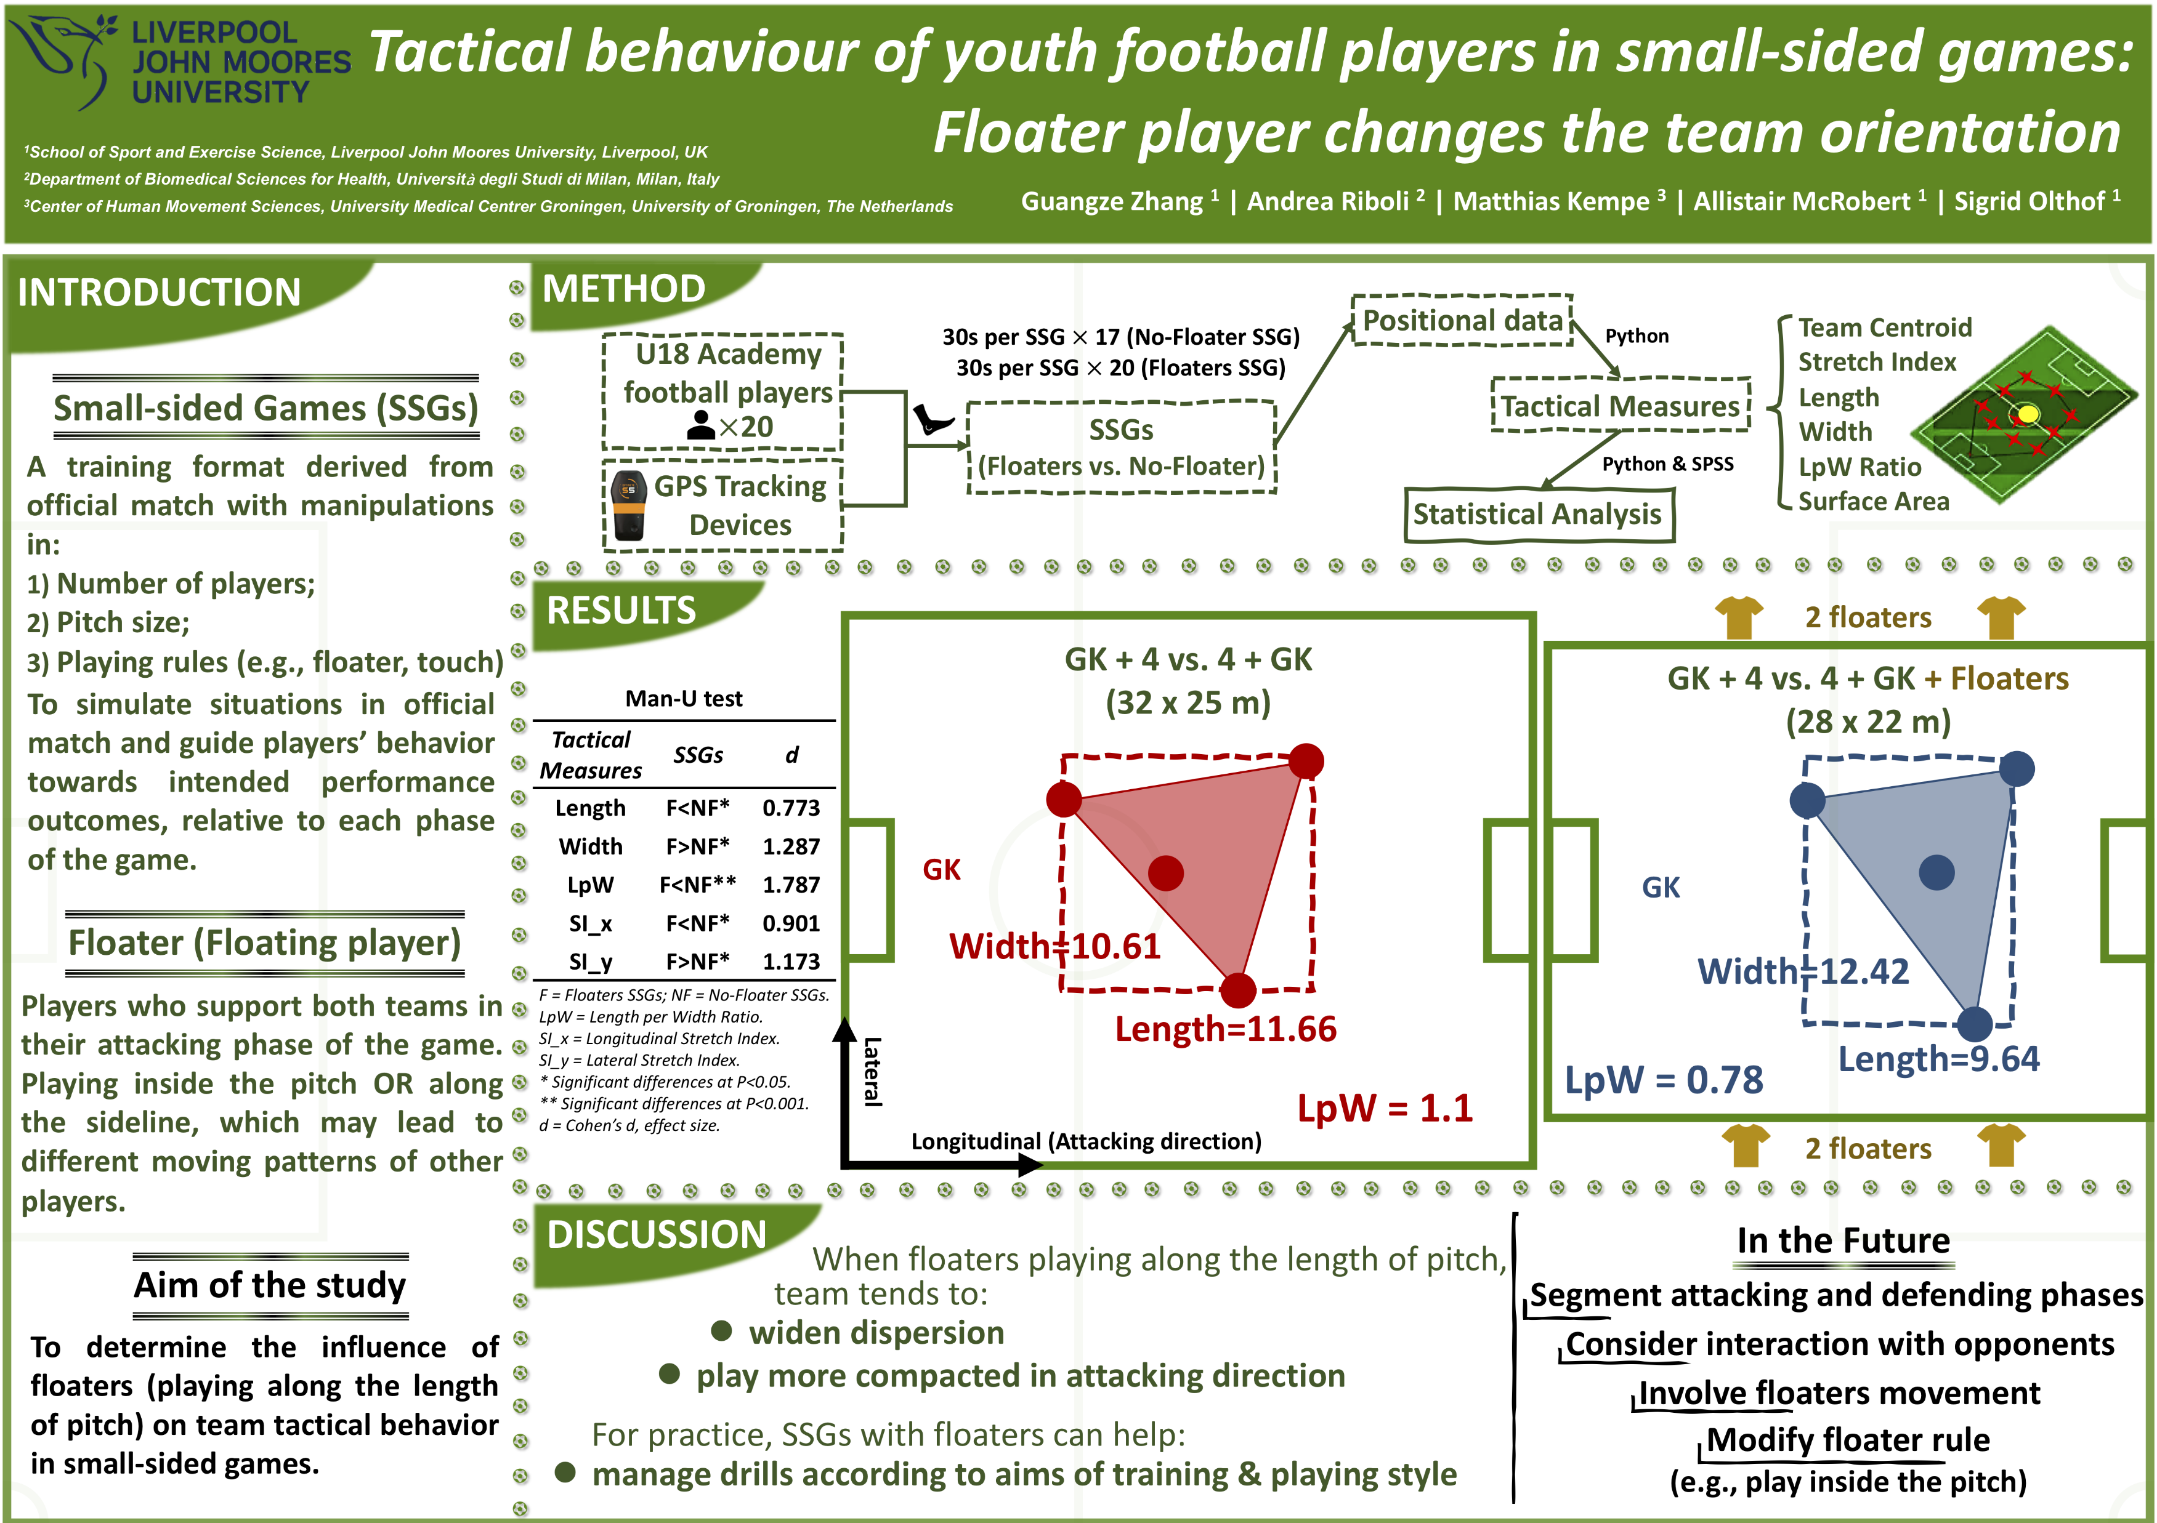
8. Guangze
Zhang, SPS

Slide 9
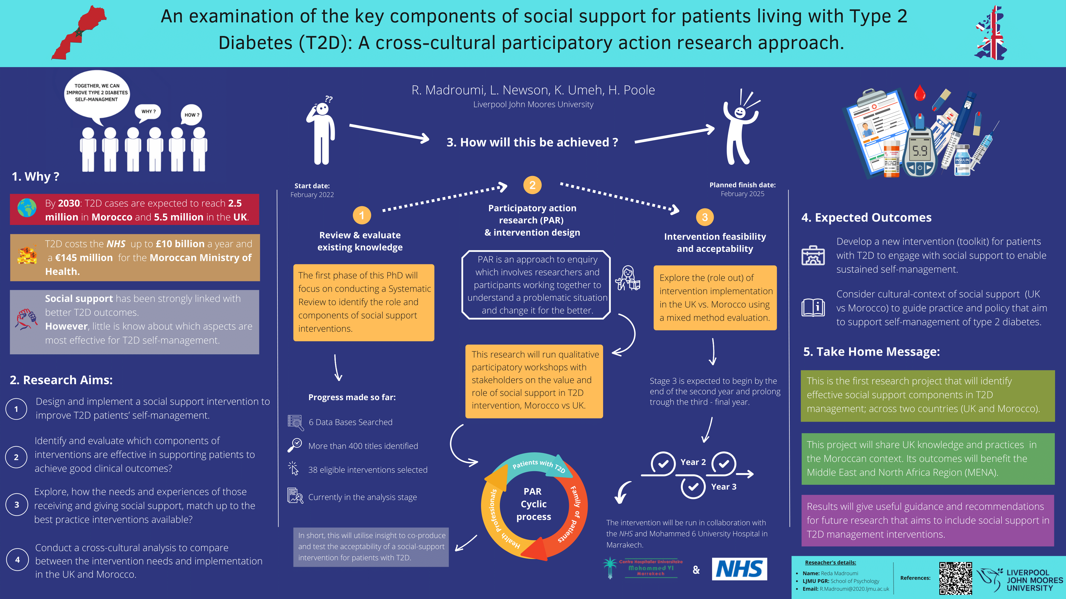
9. Reda
Madroumi,
PSY

Slide 10
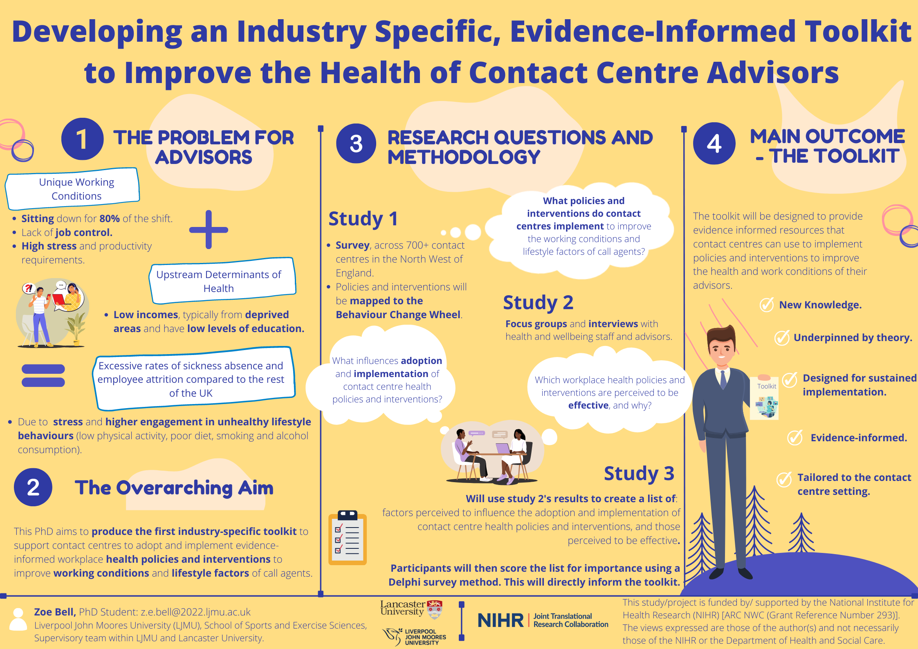
10. Zoe Bell, SPS

Slide 11
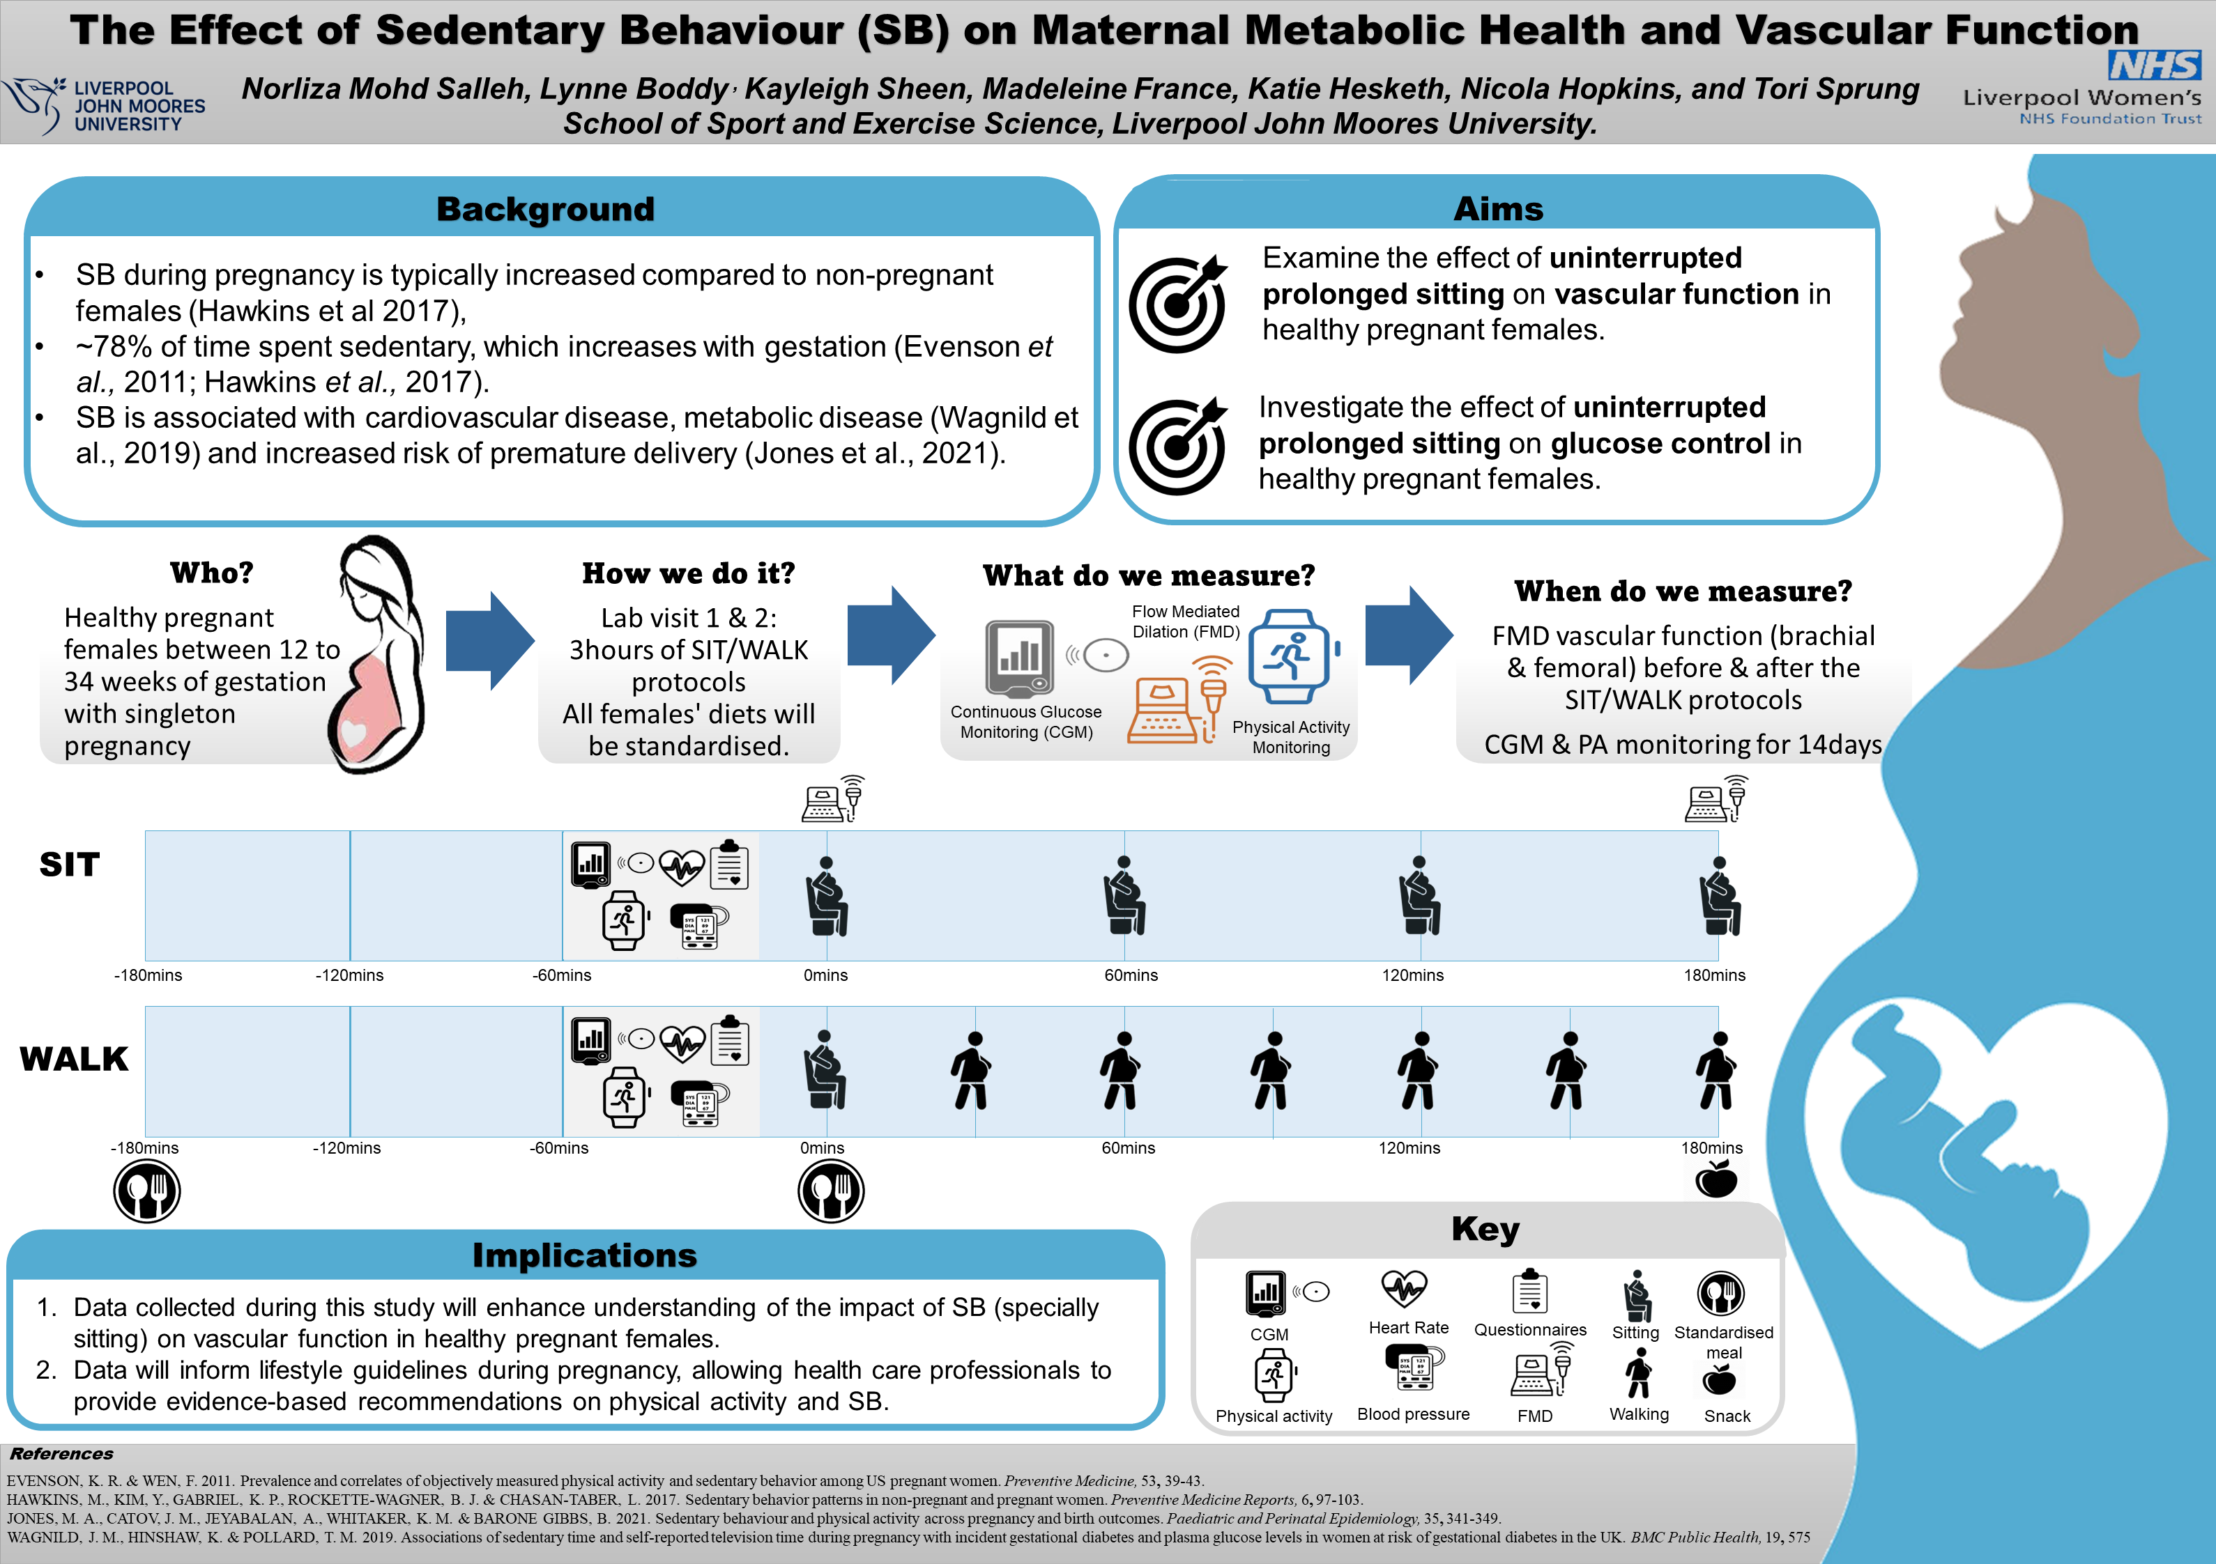
11. Norliza
Mohd Salleh,
SPS

Slide 12
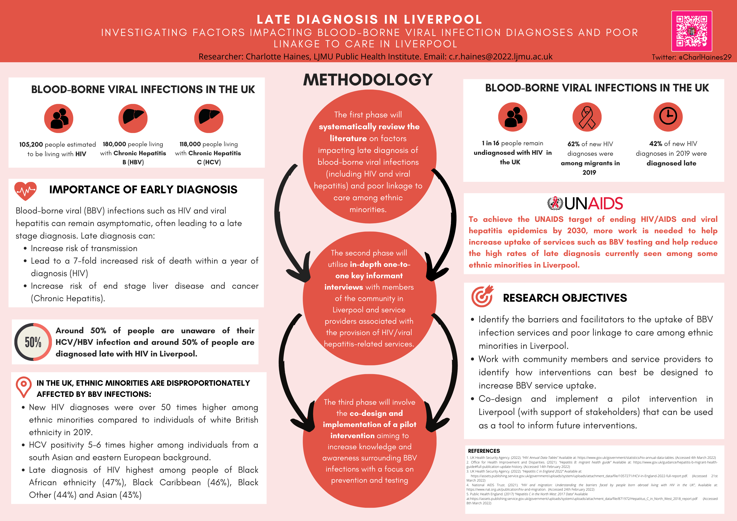
12. Charlotte Haines, PHI

Slide 13
13. Hui Liu, LBS

Slide 14
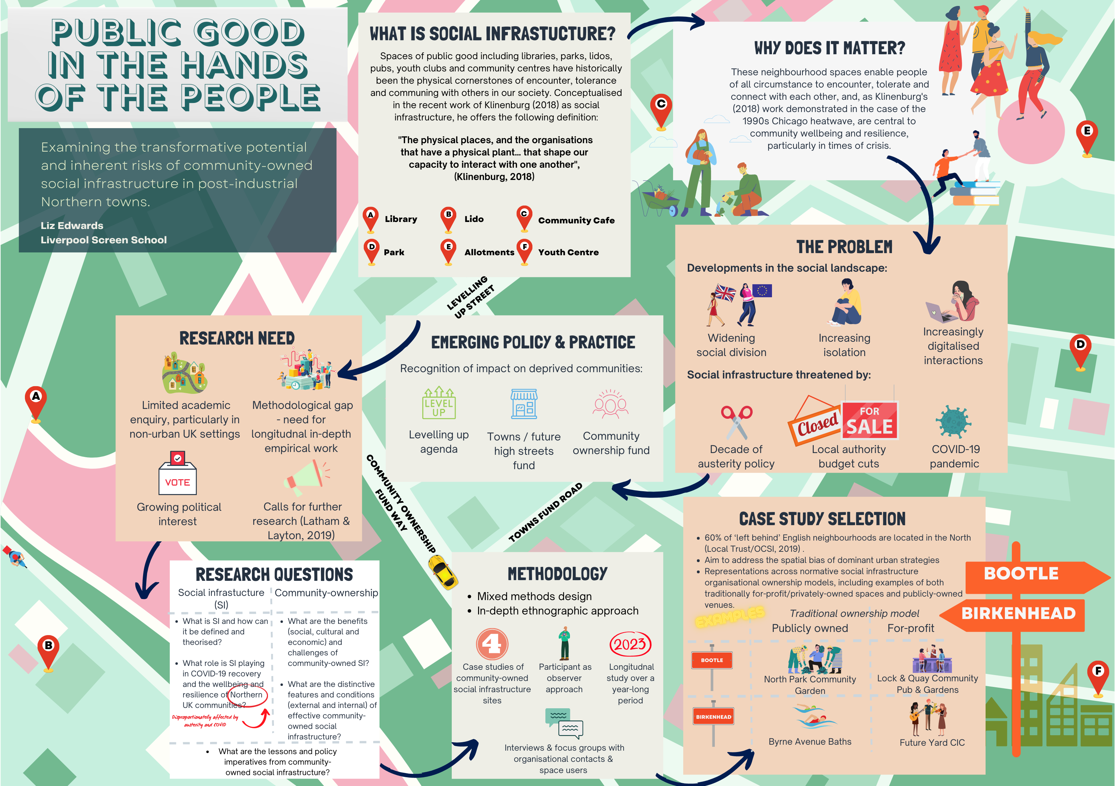
14. Liz Edwards, LSS

Slide 15
15. Gaynor Llewellyn-Jenkins, HSS

Slide 16
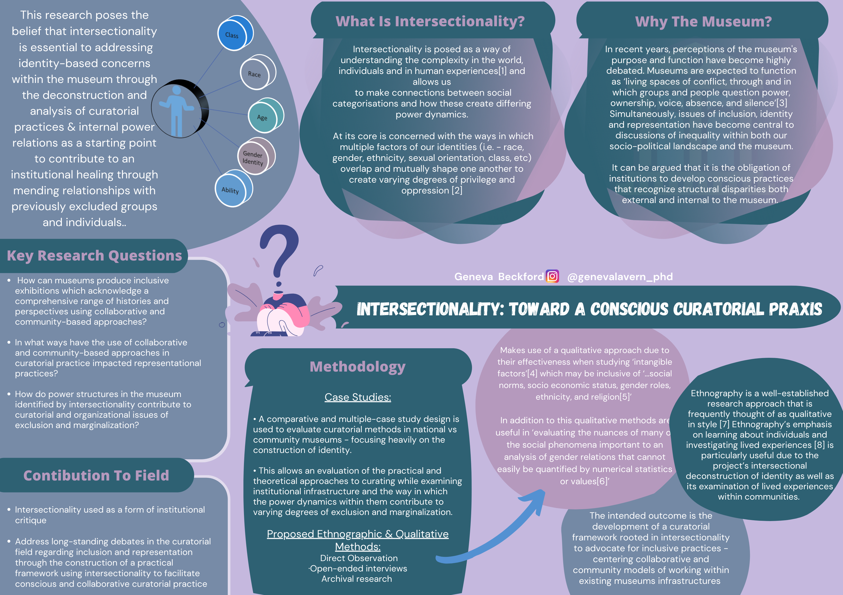
16. Geneva Beckford,
LSA

Slide 17
17. Anna Houghton, LSA

Slide 18
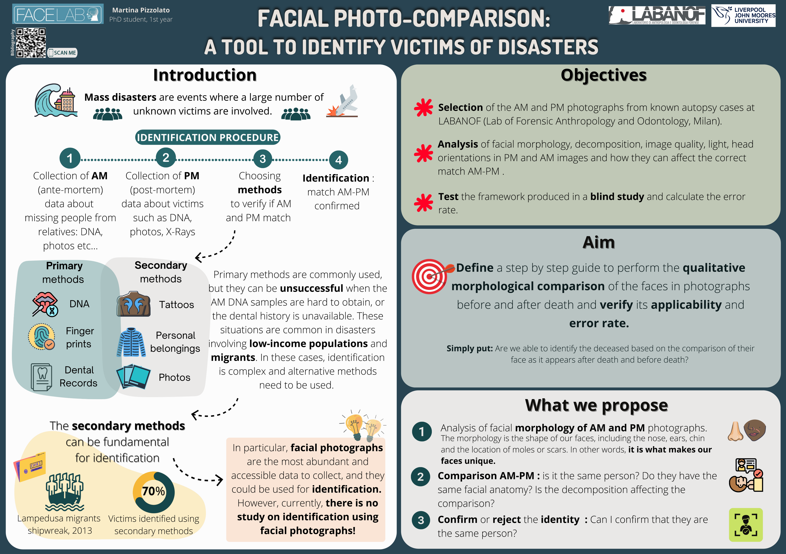
18. Martina
Pizzolato, LSA

Slide 19
19. Molly Hawker,
CMP

Slide 20
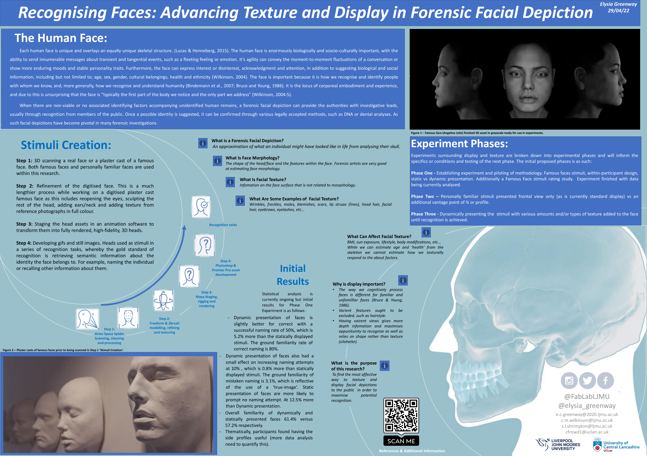
20. Elysia
Greenway, LSA

Slide 21
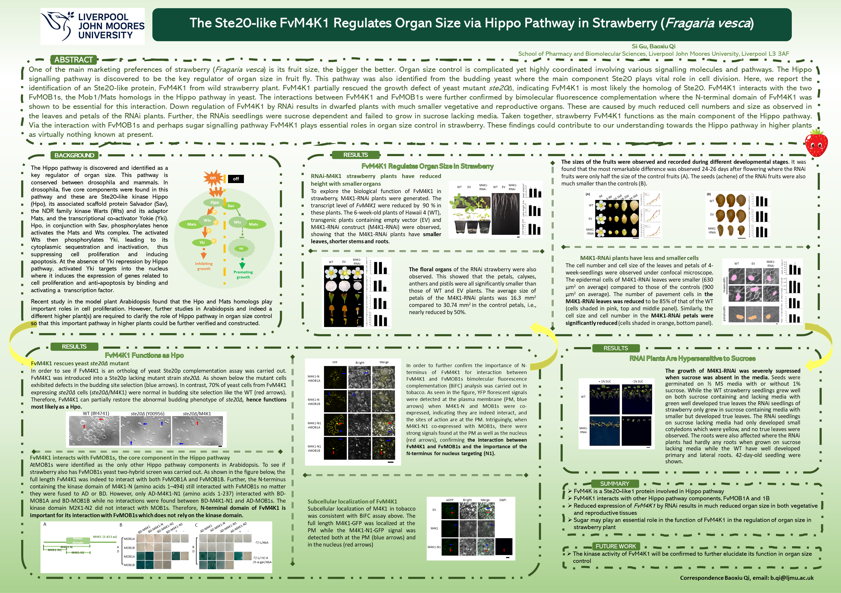
21. Si Gu,
PBS

Slide 22
22. Sian Philips, ARI

Slide 23
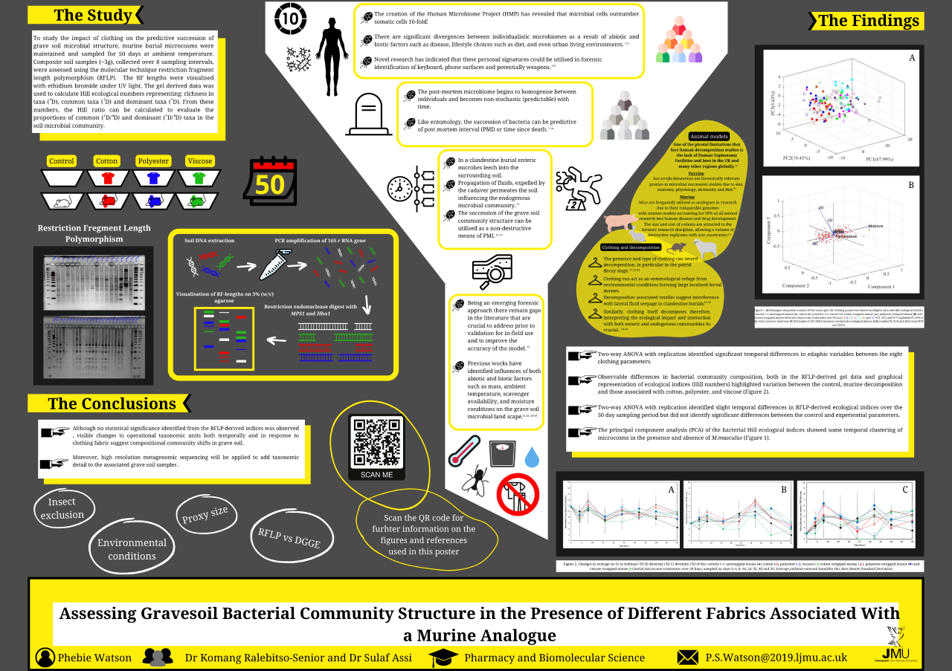
23. Phebie Watson, PBS

Slide 24
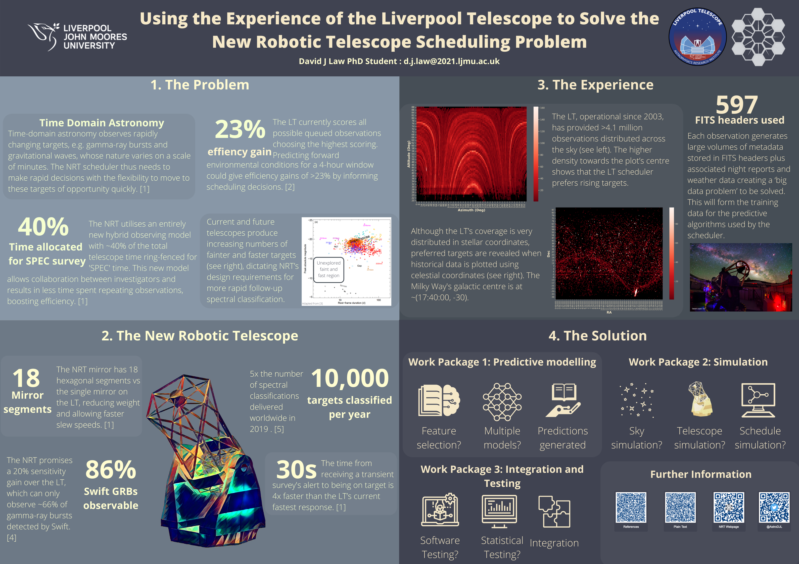
24. David Law, ARI

Slide 25
25. David Hitchmough, ENG

Slide 26
26. Caighley Logan, PBS

Slide 27
27. Bingyu Mu, ENG

