Slide 1
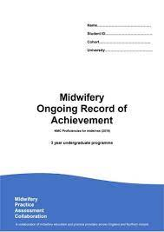
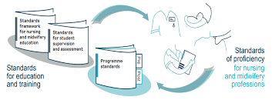
A Guide to using the Midwifery Ongoing Record of Achievement (MORA) for students and midwives
This Guide is developed from the original MORA guide (MPAC & Gillman, 2020)
(McNamara, S., & Beacock, M., 2021)​
Liverpool John Moores University

Slide 2
Glossary
Academic Assessor (AA) – a midwifery lecturer who is assigned to oversee student clinical practice (changes each year), including hours and progress
BFI – UNICEF Baby Friendly Initiative - Global Infant feeding initiative
EU directives – certain clinical requirements set out by the European parliament and required for midwifery students a midwifery students i.e. 40 births
Mapping – linking or aligning requirements (in this case NMC proficiencies) to documents (modules, programmes)
NIPE - an in-depth newborn physical examination undertaken within 72 hours of birth
NMC domains – 6 themes set by the NMC which organise the proficiencies
NMC proficiencies – set by the NMC, & need to be achieved in order to register as a midwife
Non-midwifery placement – a placement other than a maternity one i.e. gynaecology
PARE (Practice Assessment Record & Evaluation) - the online platform which contains the MORA document and other resources for practice, including help guides
PEF – Practice Education Facilitator – works within a Trust and oversees programmes of education, links with the University
Practice Assessor (PA) – a registered midwife who oversees student progression in clinical practice using feedback from the PS, meets with student 4 times a year
Practice Supervisor (PS) – a registrant (usually a midwife) who is responsible for student teaching and learning in clinical practice
Time sheet – an electronic record of the hours completed in practice

Slide 3
Why is this guide needed?
Students and clinicians should be aware that most of the information required to use the MORA is contained within the MORA document. This guide has been produced to assist the student/clinician to use MORA effectively
Please note, different universities (HEIs) may use their own ‘mapping document’ to outline where NMC proficiencies are correlated to their programme, modules and year specific requirements. This mapping document may help you to ascertain where individual proficiencies may be achieved according to HEI programme plans
Notes:
The Midwifery Ongoing Record of Achievement (MORA) has been designed by the Midwifery Practice Assessment Collaboration (MPAC) in England and Northern Ireland to document the achievement of the skills within Domain 6 of the NMC Standards of proficiency for midwives (2019)[1] as indicated in the accompanying MPAC MORA mapping document (TABLE 1).
The MPAC MORA is designed to enable some flexibly in how each Approved Education Institution utilises it within the midwifery programmes being offered. This context document provides the detail regarding local implementation in relation to LJMU university regulations and programme structure/requirements.
[1] NMC (2019) Standards of proficiency for midwives https://www.nmc.org.uk/globalassets/sitedocuments/standards/standards-of-proficiency-for-midwives.pdf

Slide 4
What is MORA?
The Midwifery Ongoing record of Achievement (MORA) is:
A single national document that spans the duration of training
Notes:
The Midwifery Ongoing record of Achievement (MORA) is:

Slide 5
MORA Contains
All of the NMC proficiencies required to attain a midwifery qualification
All of the EU directives (2005) required to attain a midwifery qualification
Different sections relating to care across the childbirth continuum:
Antenatal, intrapartum, postnatal, neonatal proficiencies
Promoting excellence (including leadership proficiencies)
BFI standards
NIPE standards (systematic examination of the newborn)

Slide 6
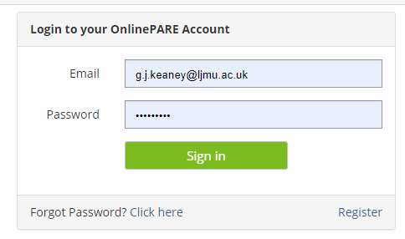
How to access PARE
An email will be sent to you when your details are first added to the PARE system by an administrator, this email will contain a link which allows you to create your OnlinePARE account. If you do not receive an authentication email, you should contact the PARE helpdesk on info@onlinepare.net
When you receive your authentication email you will be asked to choose a password.
To login use your registered email address as your username and insert the password you chose during initial registration.
To change your password go to your profile when logged into your account: enter your existing password, choose a new password and confirm.

Slide 7
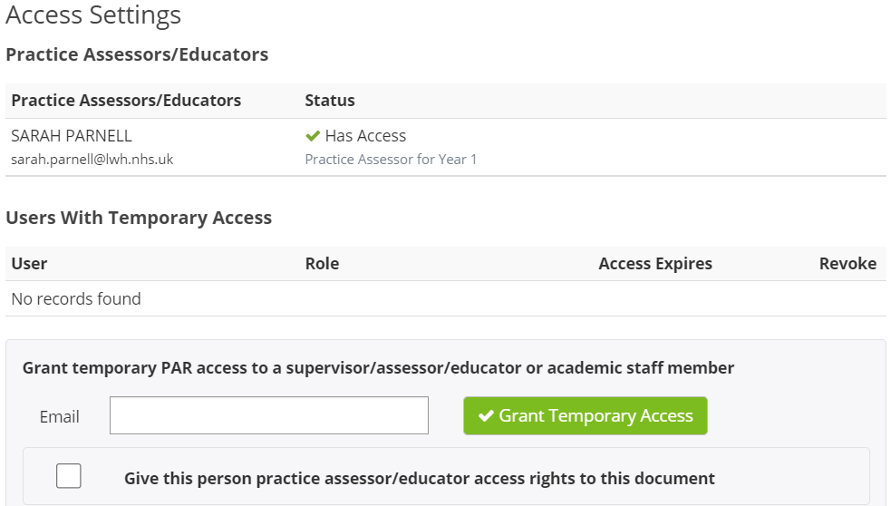
How to add temporary access for a Practice Supervisor:
Click on
Document Settings (on MORA homepage)
Add in
The clinician's email
Select
Grant Temporary Access
n.b Access will be for 4 weeks, so for longer placements, this access route will need to be repeated if required. Learners are able to grant access to Practice Supervisors only.

Slide 8
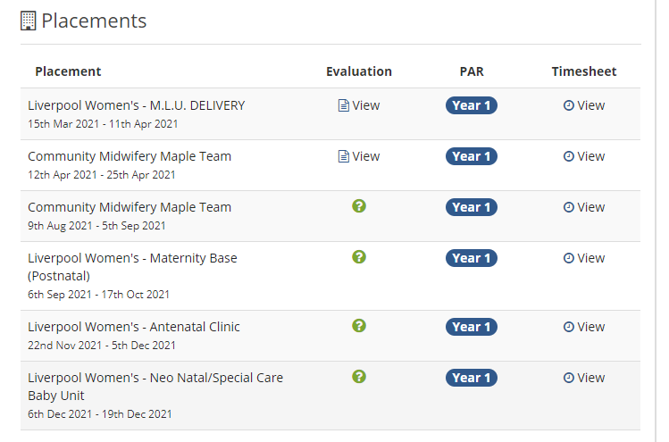
How to access Timesheets on PARE
Use the search box to find your MORA doc and timesheet (or your student's info)
Click on to open timesheet
Click on (2 or 3) to access MORA doc

Slide 9
Who can complete the MORA?
Guidance within the MORA details who can complete each section. This should be read in conjunction with the roles and responsibilities of each party.
For full details refer to the NMC (2018) Standards for student supervision and assessment:
https://www.nmc.org.uk/globalassets /sitedocuments/educationstandards/student-supervisionassessment.pdf
If you are unsure about any aspect of completion in the MORA, please check with either the PEF/student link or other academic link for your practice area.

Slide 10
Key MORA elements
1. Practice episode records (EU directives, Breastfeeding Assessment Tool and systematic examination of the newborn)
2. NMC Proficiencies
3. Service User feedback
4. Practice Supervisor feedback
5. Student reflection
6. Practice Assessor assessment
7. Academic Assessor sign-off

Slide 11
NMC Proficiencies relate to:
Antenatal Care
Intrapartum care
Postnatal Care
Neonatal Care
Promoting Excellence

Slide 12
NMC Proficiencies
The proficiencies can be assessed in a range of placements as part of a continuous assessment process
Proficiencies should not be viewed as separate elements but reflect the continuum of care provided in partnership with women and their families
During each year of the programme, students are expected to engage at varying levels appropriate to their knowledge, understanding and level of study (see next slide)
NMC (2019) https://www.nmc.org.uk/globalassets/sitedocuments/standards/standards-of-proficiency-for-midwives.pdf
Notes:
The MORA does not indicate specific proficiencies that should be achieved for each stage of the programme. This is in line with the NMC outcomes focused approach and recognises the local variation in programme structure and practice learning opportunities. However, to ensure that students are making sufficient progress towards meeting the proficiencies by the end of the programme, there may be individual HEI programme specific guidelines in place.
Students do not have to achieve all of the proficiencies in years one and two of the programme. They can achieve the required level of engagement when they have the opportunity to participate (year one) or contribute (year two). Students could therefore identify as having met a competency at each level of the programme.
Practice Supervisors should only confirm proficiency in the column that relates to the student’s current part of the programme. This is to ensure that students maintain proficiency and that at the point of progression to the NMC register they have demonstrated the required proficiencies within the final part of their programme underpinned by the relevant theory and application to practice.
Students are expected to be able to demonstrate achievement of all proficiencies at the final point of progression in year three in order to qualify to enter the Midwifery Register.
LJMU. The required NMC (2019) proficiencies as laid out in the MORA practice document are mapped against each LJMU programme module, which are in turn are mapped in detail against the student’s placement areas (see separate document – LJMU MORA mapping document).
Before each of the students’ meetings with their practice assessor, they should consider their placement area and examine the LJMU MORA mapping document. These can be used as a guide as to the range of proficiencies they could achieve in this area. The student and practice assessors will meet at the required intervals to plan and document how the skills in the next placement(s) can be met, using the mapping document to guide them. They should ensure that a broad range of proficiencies are met across the domains applicable to that year and placement.

Slide 13
Expected level of engagement (year specific) (Proficiencies remain the same throughout)
Year 1
Participate
work closely with midwives and other health and social care practitioners and take part (participate) in the activities that are undertaken under direct supervision and direction.
Year 2
Contribute
contribute to providing care for women, their babies and their families under close supervision and direction, appropriate to knowledge and skills.
Year 3
Demonstrate proficiency
provide care for women, their babies and their families in partnership with midwives and other health and social care practitioners, with appropriate supervision and direction as knowledge and skill increases.
Notes:
Students will be expected to attain proficiencies in line with module learning in the year that they are currently studying in (see MORA mapping document).
For example:
First year students may experience obstetric emergencies, but will not be expected to manage them, but this is the expectation for third year students.
First years are not expected to ‘manage, supervise, support, teach and delegate care responsibilities to other members of the midwifery and interdisciplinary team’ (E2, MORA) as third years are, but they may display these skills in some situations, or may participate appropriately at their year level - therefore this field may be signed.

Slide 14
The student journey and MORA ensures that a broad range of proficiencies are met across the NMC (2019) domains
Domains
1 | Being an accountable, autonomous, professional midwife
2 | Safe and effective midwifery care: promoting and providing continuity of care and carer
3 | Universal care for all women and newborn infants
4 | Additional care for women and newborn infants with complications
5 | Promoting excellence: the midwife as colleague, scholar and leader
6 | The midwife as skilled practitioner

Slide 15
How many Proficiencies are needed?
See slides 16 & 17
The expectation is that students should be able to achieve most of the proficiencies in each level
It is NOT a requirement that all proficiencies are achieved during year 1 and year 2 of the programme, however they must pass the summative holistic assessment each year to progress

Slide 16
LJMU MORA Proficiencies required for each year
MORA section | Antenatal | Intrapartum | Postnatal | Neonatal | Promoting excellence | BSc Y1 | BSc Y2 | BSc Y3
Continuity of care | A1 | IP1 | P1 |  |  | X | X | X
Relationship building | A2 | IP2 | P2 |  |  | X | X | X
Infant feeding |  |  | P5 | N2 |  | X | X | X
Communication | A3 | IP3 | P3 |  |  | X | X | X
Universal care | A4 | IP4, IP5 | P4 | N1 |  | X | X | X
Public health | A5 |  | P6 |  |  |  | X | X
Medicines administration | A6 | IP6 | P7 | N3 |  | X | X | X
Record keeping | A7 | IP7 | P8 | N4 |  | X | X | X
Interdisciplinary working | A8 | IP8 | P9 | N5 | E1 |  | X | X
Additional care | A9 | IP9 | P10 | N6 |  |  | X | X
Supervision and delegation |  |  |  |  | E2 |  |  | X
Management |  |  |  |  | E3 |  |  | X
Responding to vulnerability |  |  |  |  | E4 |  |  | X

Slide 17
Edge Hill MORA Proficiencies required for each year & Programme
MORA section | Antenatal | Intrapartum | Postnatal | Neonatal | Promoting excellence | BSc Y1 | BSc Y2 | BSc Y3 | MSc Y1 | MSc Y2
Continuity of care | A1 | IP1 | P1 |  |  | X | X | X | X | X
Relationship building | A2 | IP2 | P2 |  |  | X | X | X | X | X
Infant feeding |  |  | P5 | N2 |  | X | X | X | X | X
Communication | A3 | IP3 | P3 |  |  | X | X | X | X | X
Universal care | A4 | IP4, IP5 | P4 | N1 |  | X | X | X | X | X
Public health | A5 |  | P6 |  |  |  | X | X | X | X
Medicines administration | A6 | IP6 | P7 | N3 |  | X | X | X | X | X
Record keeping | A7 | IP7 | P8 | N4 |  | X | X | X | X | X
Interdisciplinary working | A8 | IP8 | P9 | N5 | E1 |  | X | X | X | X
Additional care | A9 | IP9 | P10 | N6 |  |  | X | X |  | X
Supervision and delegation |  |  |  |  | E2 |  |  | X |  | X
Management |  |  |  |  | E3 |  |  | X |  | X
Responding to vulnerability |  |  |  |  | E4 |  |  | X |  | X

Slide 18
Knowledge of Proficiencies
Before each of the students’ meetings with their practice assessor, they should look at the upcoming placement areas, and plan the range of proficiencies they could achieve in this area
The student and practice assessors should meet at the required intervals (see slides 41 & 42) to plan and document how the skills in the next placement(s) can be met - using mapping tools if necessary to guide them
PAs and PEFs should ensure that the proficiencies are planned and met across the domains applicable to that year and the placement(s) available to the student
Students should have an understanding of the proficiencies they can achieve and should guide practice supervisors to the relevant proficiencies

Slide 19
Level of proficiency to record
Students can meet any proficiency at any level if they have met the criteria. However they must be signed specific to the students' current level. For example:
'E4.2 identifying vulnerability of other individuals providing support and/or referring for intervention as needed' - although this is a level 6 skill, it should be signed off at level 4, but must be signed again when the student is at level 6.
Students do not have to achieve all of the proficiencies in years one and two of the programme. They can achieve the required level of engagement when they have the opportunity to participate (year one) or contribute (year two). Students could therefore identify as having met a competency at each level of the programme
Students will be expected to attain proficiencies in line with module learning in the year that they are currently studying in (see MORA mapping document)
First year students may experience obstetric emergencies, but will not be expected to manage them. However this is the expectation for third year students
First years are not expected to ‘manage, supervise, support, teach and delegate care responsibilities to other members of the midwifery and interdisciplinary team’ (E2.5) as third years are, but they may display these skills in some situations, or may participate appropriately at their year level - therefore this field may be signed

Slide 20
Level of proficiency to record
If students are unable to achieve these proficiencies in practice in year 3, simulation could be used, and proficiency confirmed in the university environment
Practice Supervisors should only confirm proficiency in the column that relates to the student’s current part of the programme. This is to ensure that students maintain proficiency and that at the point of progression to the NMC register they have demonstrated the required proficiencies within the final part of their programme underpinned by the relevant theory and application to practice
Students will always need to make sure that they are practising according to local policy
The expectations of student achievement are 'participation' in year 1 and 'contribution' in year 2. It is only the year 3 expectation that states, 'demonstrates proficiency' which should be under appropriate supervision

Slide 21
Completion of Proficiencies
Note: Competence is competence – therefore Practice Supervisors (PS) should sign off a proficiency if the student competency demonstrates knowledge and competency, even if the PS has seen this only once
Students subject to a Progression Plan related to incomplete proficiencies in any one year (up to a maximum of 10%) would be permitted to progress, subject to satisfactory completion within a negotiated timeframe
Students are expected to be able to demonstrate achievement of all proficiencies at the final point of progression in year three, to qualify to enter the Midwifery Register. Students always need to make sure that they are practising according to local policy
If students are having difficulties obtaining proficiencies students should liaise with their PEF and AA as a matter of urgency
If a student misses an assessment point, then a progression plan must be started (see slides 50 and 51). If the student is struggling to arrange an assessment point, the PEF should assist
Noted concern(s) and/or lack of experience needed in clinical practice to complete the required proficiencies, should result in a tripartite meeting between student, PA and AA, and then the development of a Progression Plan. The PA is most likely to identify a problem due to the close supervision in practice, but the student or an AA may also identify an issue

Slide 22
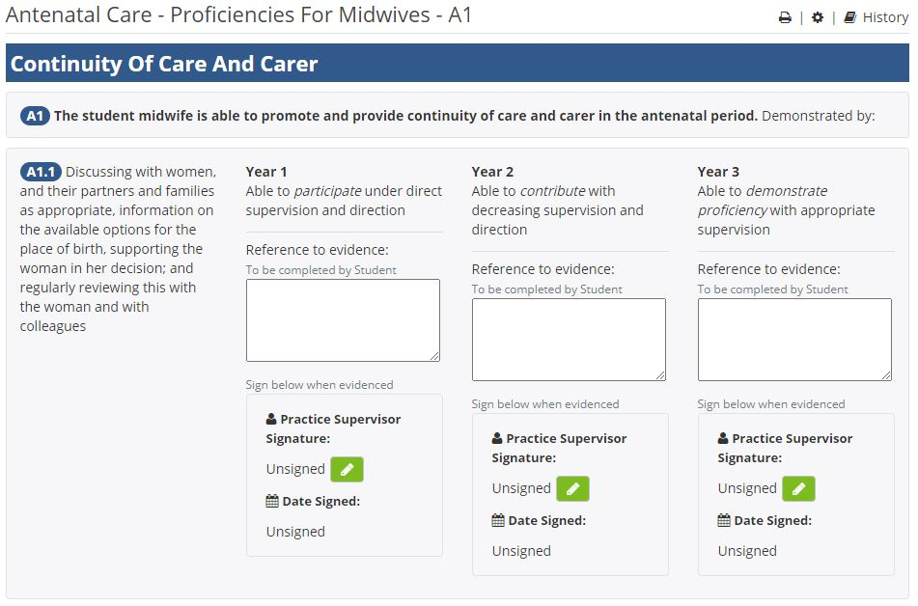
Achieving Proficiencies
In the proficiencies section is a box headed 'Reference to Evidence.' Against each proficiency the student should insert the method by which they can demonstrate achievement of the required outcome.
Methods to demonstrate achievement:
Practice Episode Records (PER)
Discussion with PS and/or PA
Demonstration
Reflection
Simulation
Participating or contributing to care in a complementary placement area

Slide 23
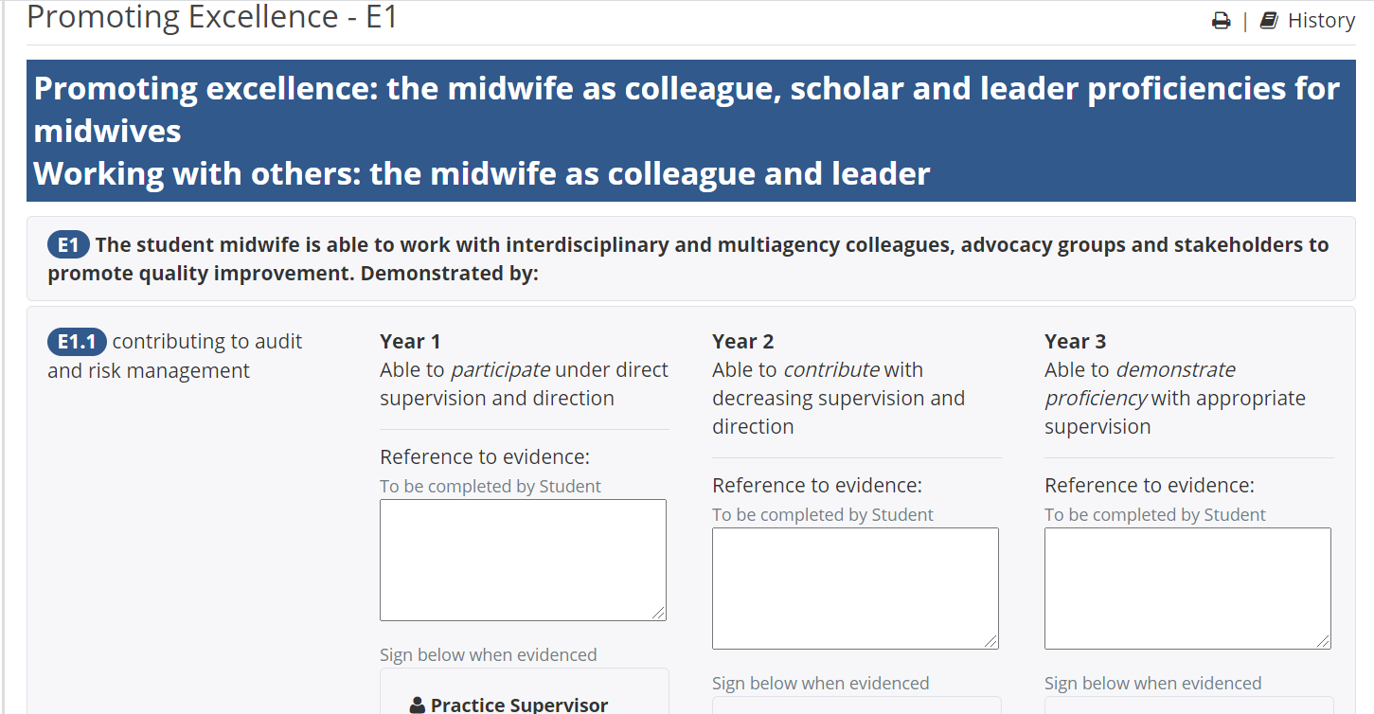
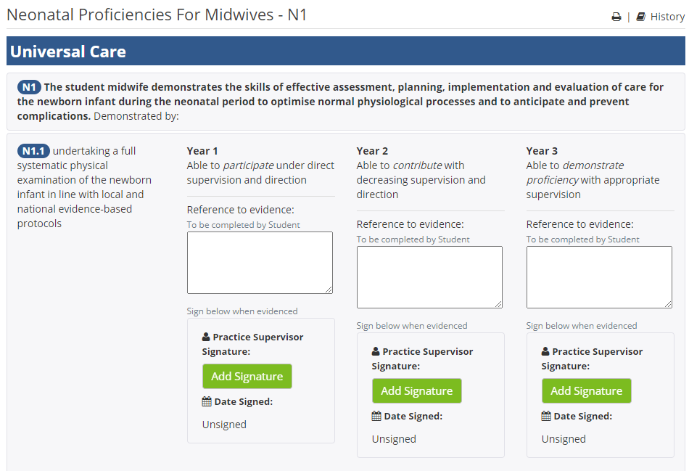
Promoting Excellence & Neonatal Care Proficiencies
Promoting Excellence examples:
E1.1 contributing to audit and risk management
E1.2 contributing to investigations of critical incidents, near misses and serious event reviews
E1.3 being an advocate for change, using negotiation negation and challenge skills and evidence informed approaches to support change
Neonatal Care examples:
N1.1 undertaking a full systematic physical examination of the newborn infant in line with local and national evidence-based protocols
N6.4 undertaking delegated tests for the newborn infant as appropriate
Promoting Excellence examples:
E1.1 contributing to audit and risk management
E1.2 contributing to investigations of critical incidents, near misses and serious event reviews
E1.3 being an advocate for change, using negotiation negation and challenge skills and evidence informed approaches to support change
Neonatal Care examples:
N1.1 undertaking a full systematic physical examination of the newborn infant in line with local and national evidence-based protocols
N6.4 undertaking delegated tests for the newborn infant as appropriate

Slide 24
Examples of how to achieve Promoting Excellence Proficiencies
E1.1 contributing to audit and risk management
Examples could include: report an adverse incident, work with audit/risk midwife or team, participate in Trust audits (e.g. BFI audit), stop someone coming onto the ward with no identification badge or reason to be there, identify spillages/hazards and report, administer a baby security tag, generate a GROW chart if absent

Slide 25
EU Directives
Advising of pregnant women, involving at least 100 antenatal examinations
Supervising and caring for at least 40 pregnant women
Supervising and caring for (including examination) at least 100 healthy newborn infants
Personally facilitating at least 40 births
Supervising and caring for 40 women at risk* during pregnancy, labour or the postnatal period
Supervising and caring for (including examination) at least 100 postnatal women

Slide 26
EU Directives
Each section of the MORA includes practice episode records to document the care provided to women or their babies to provide evidence of achieving the proficiencies.
Although students may be keen to begin recording practice episode records as soon as possible, it is advised that these are spaced throughout the student experience, as the way in which different types of care will be approached will change as students' knowledge and skills expand over the course of the programme.
As a guide, suggested completion is provided below. Please note that this is a guide only, intended to support student development.
Each section of the MORA includes practice episode records to document the care provided to women or their babies to provide evidence of achieving the proficiencies.
Although students may be keen to begin recording practice episode records as soon as possible, it is advised that these are spaced throughout the student experience, as the way in which different types of care will be approached will change as students' knowledge and skills expand over the course of the programme.
As a guide, suggested completion is provided below. Please note that this is a guide only, intended to support student development.

Slide 27
EU Directives
Students may include one woman's care in several EU categories: e.g. students may undertake an antenatal examination on admission, care for her in labour, facilitate the birth (she may be at risk/additional needs), complete a postnatal examination, complete a newborn assessment/examination and then provide feeding support (BFI)
In line with contemporaneous record keeping, all EU directives must be uploaded and signed by the students' Practice Supervisor or Practice Assessor - ideally on the same shift or within 1 week of the event
Students’ EUs are signed by the Practice Supervisor or Practice Assessor

Slide 28
Recording Births on MORA (P.31) Record Of Pregnant Women Cared For & Births Personally Facilitated (expectation: 40 records)
In previous records students recorded ‘normal births’ (over 37 weeks, to end of third stage etc.), but MORA allows opportunity to record births ‘personally facilitated’ and then record if it is universal or additional care. Examples of additional care might be IOL, medical conditions, pre 37 weeks, epidural
Universal care will encompass the normal births. Students need 40 of these for the EU directives. MORA/PARE automatically adds these up on the summary pages (p96, p108 and p120)
If 'additional care' is chosen, this allows students to record instances such as a 36+0 birth or 'additional care' as outlined in IP9, particularly noting IP9.11
‘providing care for women and newborn infants before, during, and after medical interventions such as epidural analgesia, fetal blood sampling, instrumental births, caesarean section and medical and surgical interventions to manage haemorrhage, collaborating with colleagues as appropriate’
Universal Care = (Low Risk) Care where a woman has required no intervention
Additional Care = (High Risk) Care when a woman requires any level of intervention from the ‘norm’ i.e. IOL, CTG, epidural, instrumental birth, EMCS etc

Slide 29
Recording Intrapartum Care on MORA (P.32)
Record Of Women Cared For In Labour (expectation: 40 records)
This is where students may input any episodes of intrapartum care where they care for a woman during labour but do not facilitate the birth. Examples may include instrumental birth, the woman births after the shift has ended, the woman has a category 1 or 2 caesarean section
Examples of women detailed as ’additional’ in the intrapartum section may include pre-eclampsia / IOL / Augmentation / Diabetic (on a sliding scale) / Sepsis / Epidural / Pre-term (this is not a definitive list)
Please note : Twins count as two births (if the student facilitates both births vaginally)

Slide 30
Breastfeeding Assessment Tool (p. 62, 63, 64)
This assessment tool is adapted from the UNICEF Baby Friendly Initiative Tool and aligns with UNICEF Baby Friendly standards
These standards enable staff to:
Support pregnant women to recognise the importance of breastfeeding and early relationships for the health and wellbeing of their baby
Support all mothers and babies to initiate a close relationship and feeding soon after birth
Enable mothers to get breastfeeding off to a good start
Support mothers to make informed decisions regarding the introduction of food or fluids other than breastmilk
Support parents to have a close and loving relationship with their baby
This assessment tool is adapted from the UNICEF Baby Friendly Initiative Tool and aligns with UNICEF Baby Friendly standards
These standards enable staff to:
Support pregnant women to recognise the importance of breastfeeding and early relationships for the health and wellbeing of their baby
Support all mothers and babies to initiate a close relationship and feeding soon after birth
Enable mothers to get breastfeeding off to a good start
Support mothers to make informed decisions regarding the introduction of food or fluids other than breastmilk
Support parents to have a close and loving relationship with their baby
Please note that these assessments can be undertaken below 5 days of age; but need to be amended to reflect the infants’ age

Slide 31
Systematic Examination of the Newborn (NIPE) (p. 61)
For LJMU student programme requirements, the documentation in the MORA for the full Systematic Examination of the Newborn (NIPE) does not include space for students to record the full details of the examination
The ‘systematic examination of the newborn numbers’ (NIPE) should be completed in MORA, but LJMU students are also provided with separate NIPE paper documentation practice records as per the design of the LJMU programme
The MORA enables students to briefly evidence that they have had the relevant experience and practised under the supervision of a practitioner qualified to undertake the examination
The full details of the examination will be entered into the NIPE paper document

Slide 32
Reflective Journal/Notes/Additional Evidence (p.82, 83, 84)
The basic concept of reflection is to take a skill, attitude, or event and use current evidence and a reflection model to assess it (e.g. Gibbs’, Schon, Kolb, Driscoll, Johns’, Rolfes’).
Using a model when reflecting can help students to focus on learning and self-awareness after an incident, and avoid simply retelling the events.
Reflection is not a description of events, or a diary of what has been done that day, it is a deeper learning activity. This is in order to work out how to take into future practice what has been learnt from the process and may or may or may not lead to change.
For example, students may reflect upon the incident and decide they would do something differently next time, or may come to the conclusion that they would do nothing differently because it was all appropriate.
The MORA document has the requirement for reflection built into the document. This occurs in two ways:
At each practice review point with their PA, students are expected to have completed a reflection on an incident prior to the meeting, which will be discussed during the meeting. This will feed into action planning for future practice and reviews.
There is a ‘reflective journal/notes/additional evidence requirement’ within the MORA document on pages 82 (level 4), 83 (level 5) and 84 (level 6).
Here it states:
‘Record your reflections in practice, notes about things you have learned or need to remember or any additional evidence to support your progression and achievement’.
Students should aim to complete these reflections at least once weekly, but they should be more often as required, for example if there is an incident in practice. In the case where there is an incident in practice, students may be required to write a statement, and your reflective entry could assist with this.

Slide 33
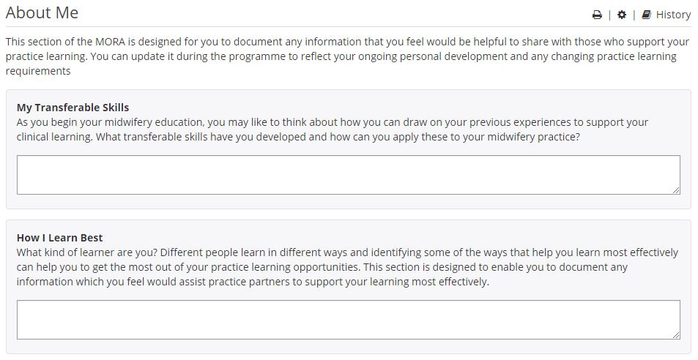
Student 'About ME section' (P. 123)
Section which facilitates students to share information that they feel will enable the PA and PS to support their learning
Students may decide to share reasonable adjustments but are not obliged to

Slide 35
MORA practice assessment process
This assessment process is the same for each year of the programme

Slide 36
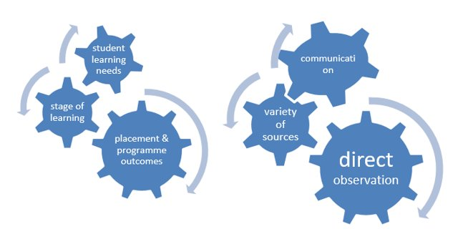
Practice Supervisors (PS)
Students are allocated to work with a PS on a day-to-day basis
PS confirm (sign) when a proficiency is met contemporaneously (remember this is year specific – see slide 16)
PS to verify (sign) timesheets contemporaneously
PS verify (sign) student practice episode records contemporaneously (i.e. EU directives, Breastfeeding Assessment Tool and systematic examination of the newborn)
PS required to provide regular structured feedback to students (students need 1-2 feedback entries per week – p. 87, 99 and 111)
PS required to seek service user feedback

Slide 37
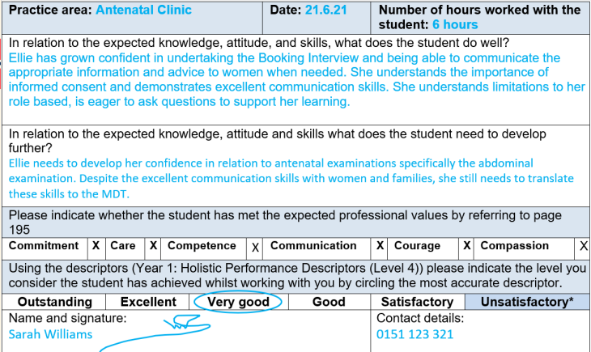
Practice Supervisors (PS) feedback forms – how to
When providing student feedback, it is important to write a comment about how well the task/day has been completed and where improvements can be made
Feedback should ideally be provided daily. The student should initiate this, getting the paperwork ready for the Practice Supervisors to complete
Feedback can be on a particular task, such as 'listening in to the fetal heartrate'. Thinking about all aspects of knowledge, skill, communication and documentation
If students do not get good quality, regular feedback this could impact their assessment and subsequent progression within the course

Slide 38
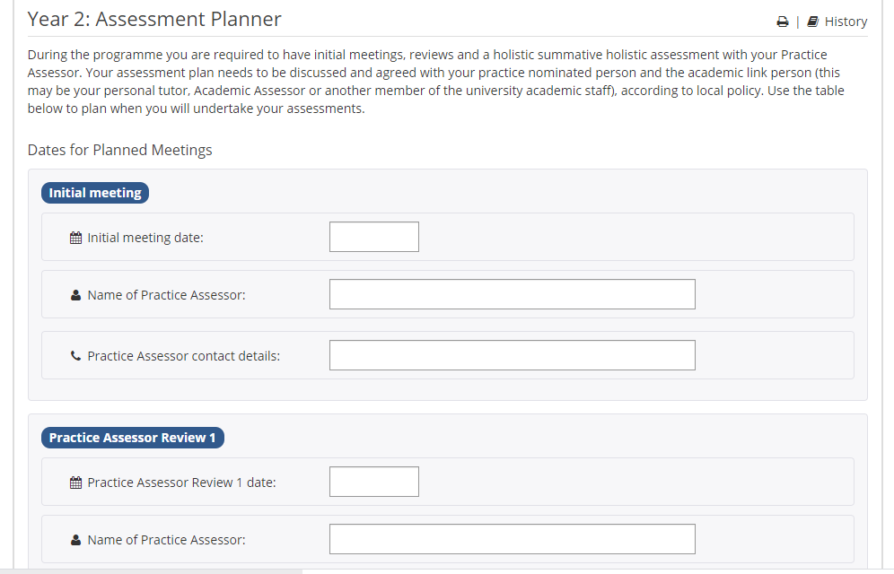
Practice Assessor (PA)
If concerns are raised at any point, the AA should be contacted by the PA or PEF
According to their Trust structure, students are allocated a PA for either the whole academic year, or for a placement or series of placements
Students meet with their PA at the beginning of the year and at regular points throughout the year (see suggested PA and student review timings on slides 41-42 but note this is HEI specific)
The Assessment Planner (p. 12, 13 and 14) in MORA should be completed by students with their PA to plan for the PA meetings
The PA should contact the Academic Assessor (AA) if the scheduled meeting did not take place, so that a Progression Plan (MORA p. 95, 106 and 118) can be initiated

Slide 39
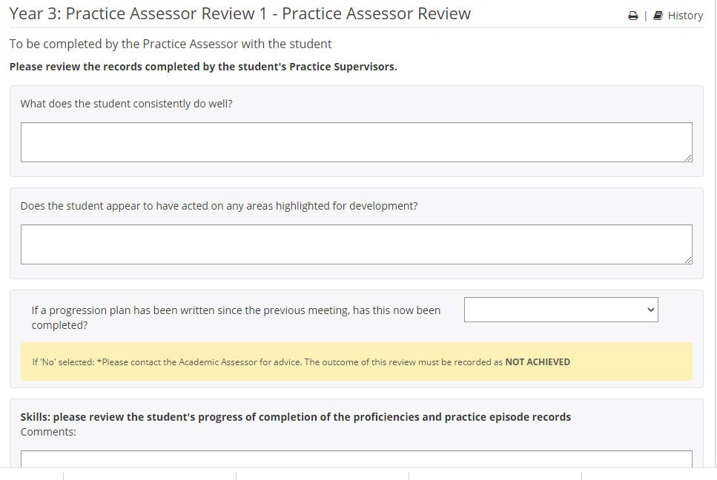
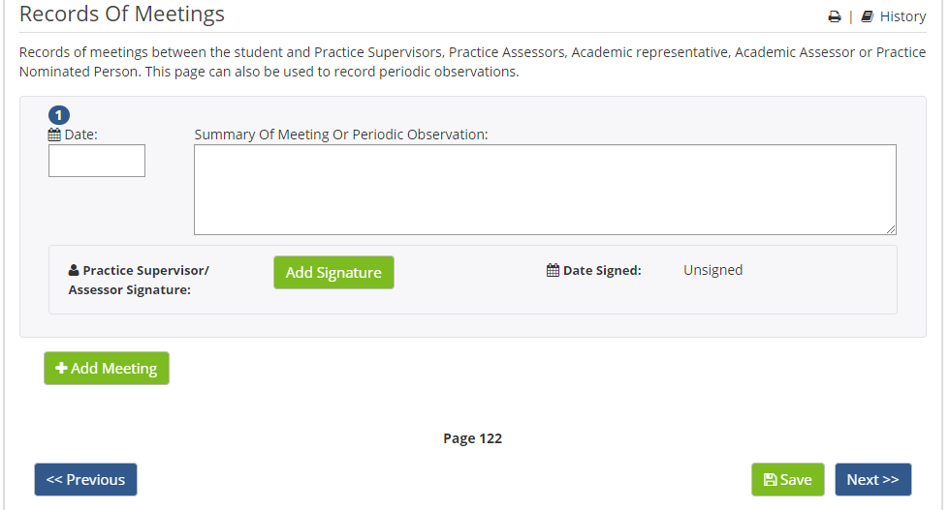
Practice Assessor (PA)
- PA to assess progress/progression
Practice Assessors undertake the reviews and summative holistic assessments
PA to review:
- PS feedback
- SU feedback
- NMC proficiencies (sufficient number attained at the stage of review)
- EU directives (sufficient number attained at the stage of review – see page 3 of MORA)
Practice assessors may also record periodic observations (p.122)

Slide 40
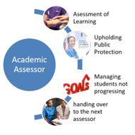
Academic Assessors (AA)
Students are allocated a different AA for each year or part of their programme
The MORA is designed to be the communication tool between PS, PA and the AA
There is no requirement for tripartite meetings, however this may be appropriate in certain situations (for example a Progression Plan)
The AA will have an understanding of the students' achievements in theory and practice
This decision informs student progression
The Practice Assessor and Academic Assessor communicate at defined points (or additionally if there are concerns raised) to make decisions in partnership, based on the evidence

Slide 41
LJMU - PA review timings
Level or part of Programme | Initial meeting | Practice Assessor Review 1 | Practice Assessor Review 2 | Summative holistic Assessment
Level 4 | First week of first practice block (November) | Last week of first practice block (December) | Last week of second practice block (March) | Last week of third and final practice block (July)
Level 5 | First week of first practice block (October) | First week of second practice block (early January) | Last week of second practice block (late February) | Last week of third and final practice block (June)
Level 6 | First week of first practice block (September) | Last week of first practice block (November) | Midway through third practice block (early April) | Last week of fourth practice block (August)
The student should liaise with their practice assessor regarding the exact dates and timings of meetings

Slide 42
Edge Hill University - PA review timings
 | Initial Meeting | PAR 1 | PAR 2 | HSA
MSc 21 | 1st week of placement | 27th February 2022 | 10th April 2022 | 7th August 2022
BSc 21 | 1st week of placement | w/c 14th February 2022 | w/c 20th June 2022 | w/c 18th July 2022 (w/c 25th July for students at Chester/Wigan)
BSc 20 | 1st week of placement | w/c 13th December 2021 | w/c 23rd May 2022 | w/c 23rd August 2022 (w/c 15th August for Chester students)
The student should liaise with their practice assessor regarding the exact dates and timings of meetings

Slide 43
Purpose of assessments
Initial meeting
Establish a relationship and mode of contact
Identify learning needs
Discuss expectations
Plan for review 1
Establish a timeline of completion
Review 1
First formative check point
Review progress including skills, knowledge and professional values
Identify areas of strength
Identify areas for development
Is a progression plan required?
Review 2
Second formative check point
Review progress including skills, knowledge and professional values
Identify areas of strength
Identify areas for development
Is a progression plan required?
Summative Holistic Assessment
Holistic assessment
Objective helicopter view informs assessment
Decide student progression - knowledge, skills and professional values
Award holistic descriptor

Slide 44
Student responsibility before PA and student review
Before the review meetings, the student should complete the relevant review paperwork:
Reflect upon a proficiency from practice
Consider which holistic assessment descriptor most closely describes their practice
Completing this before the review will ensure that the review runs smoothly and ensure that the student and practice assessor have had adequate time to reflect on progress

Slide 45
Student Reflection prior to assessment
To be completed prior to meeting with Practice Assessor
Review the feedback that you have had from Practice Supervisors and women and birthing people that you have cared for

Slide 46
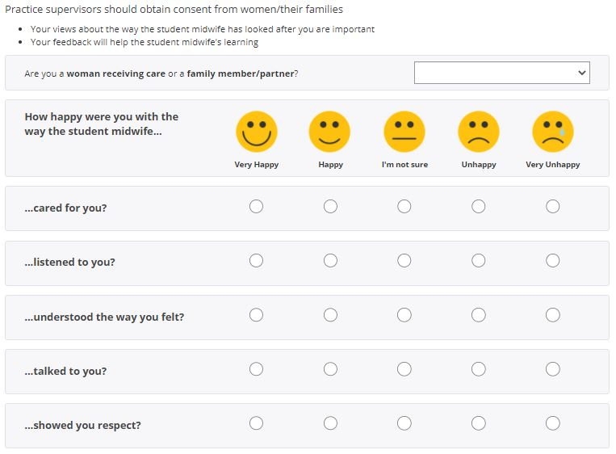
Service User Feedback
Practice supervisors should seek feedback on behalf of student midwives when it is appropriate to do so
There are feedback forms within each MORA section to enable feedback to be gathered across the maternity care continuum
Students could provide the PS with a printed copy at the start of the day. They should ask the PS to select a woman this could be given to and ask them to complete it:
e.g. This could certainly be done on a ward area when a woman is awaiting discharge, or in the IOL suite when woman have more time
SU feedback could be copied into MORA by the PS from a 'thankyou' card or from an email that relates to the students' involvement

Slide 47
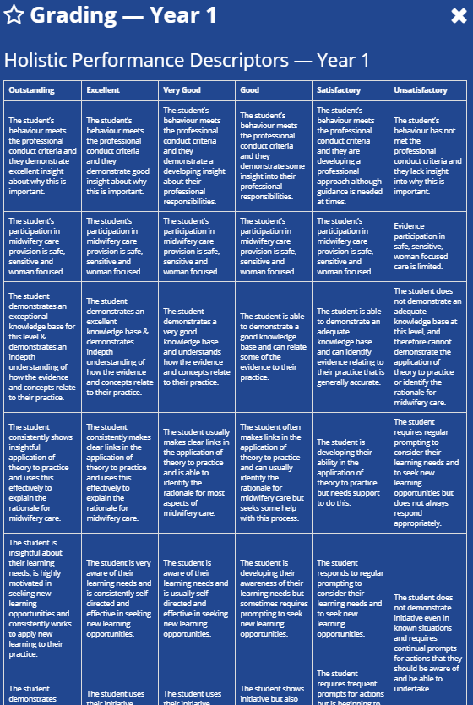
Holistic Performance Descriptors
Can be accessed from sidebar or on p. 94, 106 and 118
Both LJMU and Edge Hill students should be awarded a grade descriptor. Statements under the grade descriptor can be used to inform the grade awarded

Slide 48
Progression Plan
Previously known as an action plan
There are multiple check points to review a student's progress
However, at ANY STAGE, if there are concerns about a student's progress or performance, a progression plan can be created
Progression plans are created in partnership with the PA and the AA
The progression should be clearly documented using SMART principles
The expectation should be clear, constructive and realistic for the student to achieve
Progression plans are supportive not punitive

Slide 49
LJMU Student Progression Plan

Slide 50
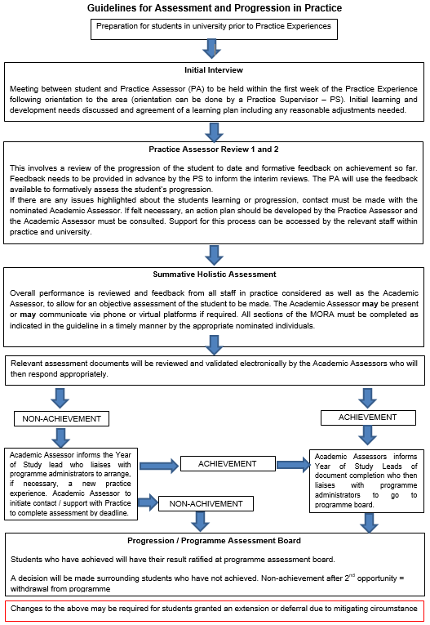
Edge Hill University Student Progression Plan

Slide 51
Summary of Progress (p. 96, 108, 120)
This page totals the EU directives achieved to date and is a quick reference guide to numbers of EU directives
In order to ascertain that the student has supervised and cared for 40 women at risk during pregnancy, labour or the postnatal period (EU directives), PAs, AAs and students will need to total the additional care boxes manually

Slide 52
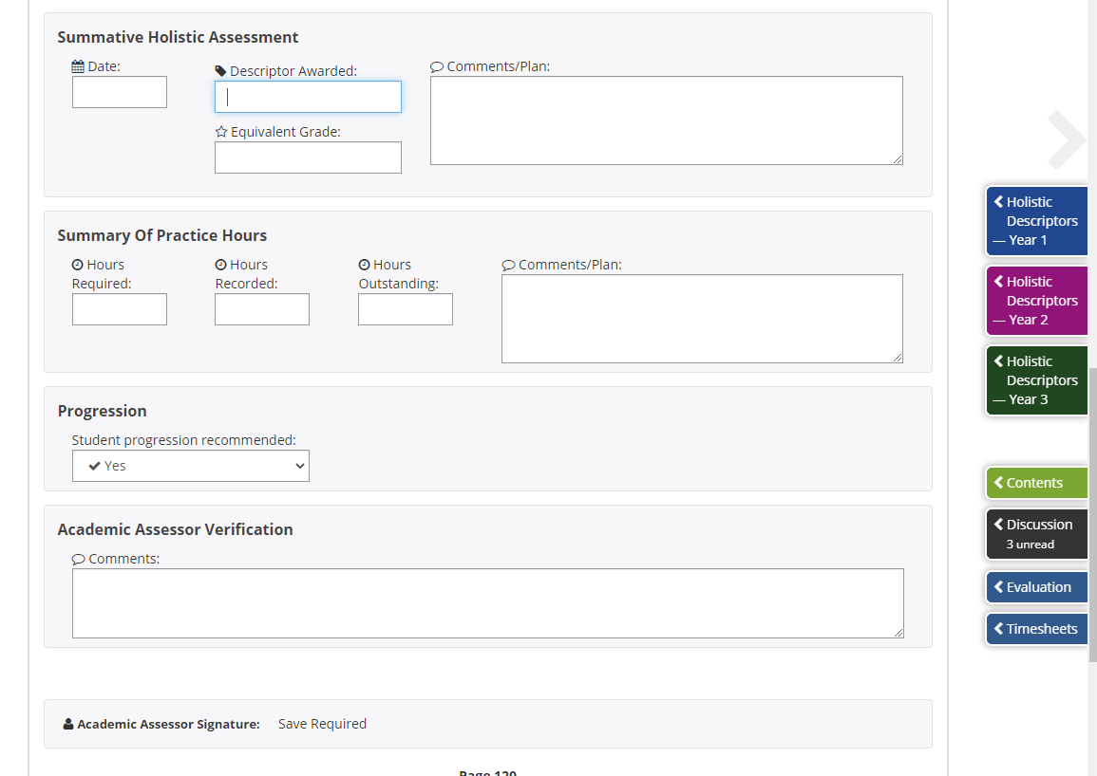
Summary of Progress (p. 96, 108, 120)
Completed by AA during MORA review at the end of the academic year
Informs progression decisions at examination boards

Slide 53
Progression Points and Holistic Assessments Points
The student must fulfill everything required at that level (see slides 16 & 17) and pass the summative holistic assessments at the required levels in year 1, 2 & 3
Each year has a different holistic assessment to represent the levels of performance expected to meet the assessment criteria at each academic level.
These describe the knowledge, skill and attitude expected across and between the levels (year 1, year 2 and year 3) The student must fulfill everything required at that level (see slides 16 & 17) and pass the summative holistic assessments at the required levels in year 1, 2 & 3
Each year has a different holistic assessment to represent the levels of performance expected to meet the assessment criteria at each academic level which describe the knowledge, skill and attitude expected across and between the levels (year 1, 2 & 3)

Slide 54
Grading in practice
LJMU and Edge Hill do not grade in practice
Students are awarded a grade descriptor to indicate how they are performing
Student either ACHIEVE progression or progression is NOT ACHIEVED

Slide 55
Non-Midwifery placements/Complementary placements (p.121)
On all placements, students should be orientated to the area as they normally would, using the ‘Orientation to practice areas’ section in MORA
A student may work with a number of Practice Supervisors Each one should complete evidence of working with the student (as in other placements)
Records can be found under ‘Record of complementary placement experience’
The student is expected to reflect on their learning, then the practice supervisor to comment. The practice supervisor may also fill out the more detailed ‘Practice Supervisor (PS) feedback on student’s performance’

Slide 56
Non-Midwifery placements/Complementary placements: Student Responsibilities (p.121)
The student should:
be clear as to what is needed from the placement area
direct the practice supervisor towards all relevant practice documentation
adhere to all placement policies and procedures in the placement area
actively participate in all learning opportunities available to them and to provide the evidence within MORA to demonstrate that their learning needs (as identified in reviews) and module learning outcomes have been met
Behave in a professional manner at all times

Slide 57
Non-Midwifery placements/Complementary placement: Placement Aims (p.121)
Introduce the student to essential skills for practice within a multi-disciplinary context, across a range of practice settings
Introduce the student to professional, legal and ethical principles that underpin practice
Introduce the student to the concept of reflective learning and practice
Introduce the student to the importance of supervision within the context of safe nursing practice

Slide 58
Non-Midwifery placements/Complementary placements:Placement Learning Outcomes (p.121)
Demonstrate an understanding of practising in accordance with 'The Code: Professional standards of practice and behaviour for nurses and midwives' (NMC, 2015).
Contribute to the Department of Health's Essence of Care Benchmark Standards in Practice settings.
Demonstrate a range of essential skills for practice
Use verbal and non-verbal communication to develop effective relationships with users, carers, relatives and the multidisciplinary team.
Contribute to working in partnership with users, carers, relatives and significant others in placement setting
Identify personal development needs and engage in reflection on learning (in the context of the practice setting)
Appreciate the necessity of skills for practice being underpinned with evidence

Slide 59
Guidance for neonatal care placement - range of skills that may be gained by the student:
Takes part in admission of neonate to a neonatal unit
Participates in assessment, planning and implementation of a care plan for a neonate
Maintains contemporaneous records e.g. baseline observations, recording vital signs
Participates in the undertaking of vital signs and observations
Is introduced to appropriate equipment and strategies to maintain a stable environment for the neonate
Demonstrates principles of infection control e.g. universal precautions
Observes / obtains samples or swabs relevant to neonatal care or treatment
Participates in neonatal investigations and screening tests
Participates in the maintenance of skin integrity
Assists with appropriate methods of infant nutrition
Follows the care of a compromised neonate
Assists in the provision of pain relief
Demonstrates correct moving and handling techniques
Participates in the care of neonates at the end of life
Demonstrates awareness of opportunistic health promotion
Gains awareness of safeguarding issues
These are some of the suggested skills that the student can focus on, it is not exhaustive

Slide 60
Guidance for placements that cover care of women with pathological conditions in the fields of gynaecology and obstetrics and initiation into care in the field of medicine and surgery - range of skills that may be gained by the student:
Takes part in admission of patient to a ward
Participates in assessment, planning and implementation of a care plan for a patient
Maintains contemporaneous records e.g. care given to patient
Participates in the undertaking of vital signs and observations
Observes risk assessment of patients using appropriate tools. e.g. Maelor score & BMI
Understand the importance of the identified risk
Participates in the assessment of tissue viability
Demonstrates principles of infection control e.g. universal precautions
Observes/participates in care for patients with infectious diseases e.g. barrier nursing
Participates in catheter care e.g. removal of indwelling urinary catheter
Observes / obtains samples or swabs relevant to patient care or treatment
Participates in wound care management
Participates in pre- and post-operative care
Assists with fluid management of patients, including accurate fluid balance
Follows the care of a patient before, during and after a surgical procedure
Assists in the provision of pain relief
Participates in the assessment of risk associated with surgery eg. VTE, infection, haemorrhage
Demonstrates correct moving and handling techniques
Demonstrates safe handling and disposal of sharps
Participates in medicines management
Participates in the care of patients at the end of life and last offices
Demonstrates awareness of opportunistic health promotion
Awareness of safeguarding issues
Undertakes a ward round, identifying the roles of the multi-professional team involved in care
These are some of the suggested skills that the student can focus on, it is not exhaustive.

Slide 61
Management of timesheet and hours
As the requirement for reflection is built into the BSc (Hons) Midwifery Programme and your MORA practice document, your reflective time is counted as part of your practice hours
For every 37.5 hours you do in practice, you will be awarded a further 2.5 hours, making your working week total 40 hours:
This takes in to account the preparation time required for your practice assessments
planning your proficiencies
spending time doing reflections
and spend time discussing your proficiencies with staff.
You are automatically credited this time by PLSU each year, so you do not need to do anything to your timesheet. You should still complete 37.5 hours in practice.
Students' need to ensure that they get their PARE timesheets signed daily when on shift by the PS and/or PA.
Students can only work a maximum of 48 hours per week when in theory or practice.

Slide 62
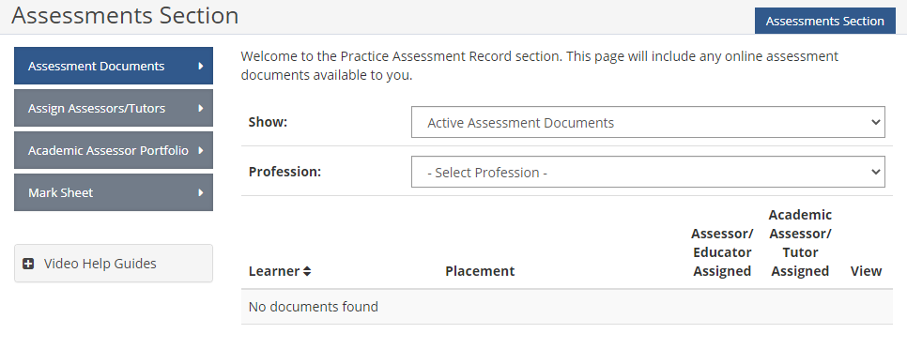
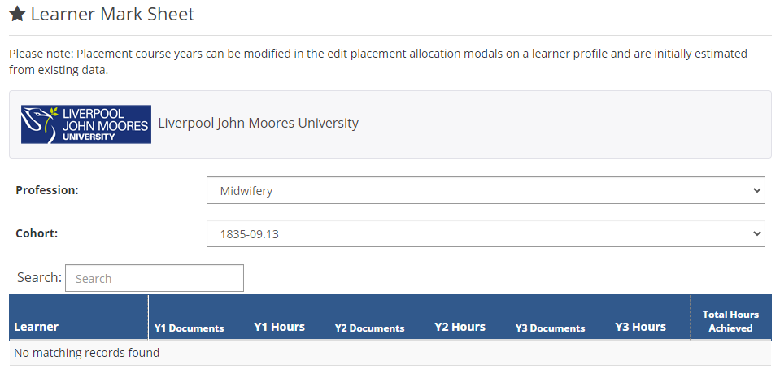
How to find a students' total hours of clinical practice on PARE (AA only)
Click on
Assessment
Click on
Mark sheet
Select
Midwifery and Cohort Year

Slide 63
Sign off Checklist
Year Led Sign-offs
EU Directives
Assessment
Service User feedback (*8 per academic year)
Breastfeeding Assessment Tool (x10 per academic year)
Year specific Proficiencies
Reflective Journal/ Notes/ Additional Evidence (1-2 per week)
Antenatal examinations
Record of births witnessed
Births facilitated
Record of women cared for in labour
Postnatal examinations undertaken
Record of Ongoing Assessment
of the Newborn
Systematic Examination of the Newborn (LJMU = NIPE Papre Clinical Records)
Initial meeting
PS feedback on student performance (1-2 per week)
PA Review 1 - Student Reflection
PA Review 1 - Practice Assessor
PA Review 2 - Student Reflection
PA Review 2 - Practice Assessor
Summative Holistic Assessment - Student Reflection
Summative Holistic Assessment - Practice Assessor

